Slide 1


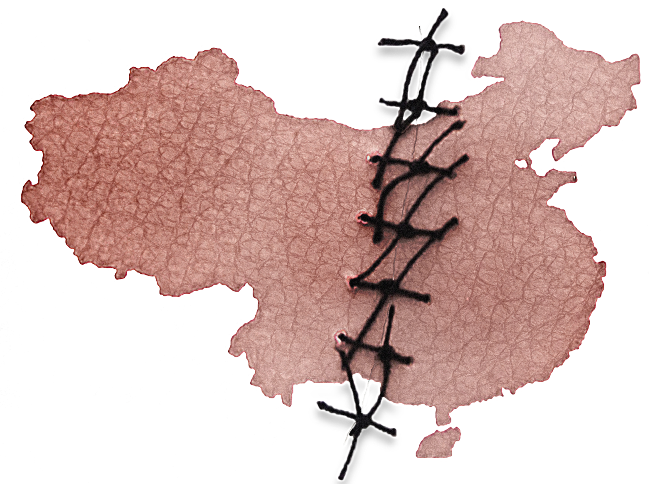
China’s Expanding Organ Transplant Abuse and
Its Implications for International Health Policy
Sample Slides for a
30-Minute Presentation
Notes:
In 2006, allegations first came to light that prisoners of conscience were being killed on demand in detention facilities and hospitals throughout China to provide organs for its vast transplantation industry. Since then, international researchers have continued to investigate these allegations.
China Organ Harvest Research Center (COHRC) is a nonprofit organization based in the United States. It conducts and presents the latest research on organ transplant abuse in China, including the killing of prisoners of conscience for organs. While China Organ Harvest Research Center is a relatively new name, our research team has been working on this issue for over a decade.

Slide 2
Methodology
Challenges we faced:
State secret
Evidence has been systematically destroyed
Data falsified level by level
True number unknown
We examined hundreds of hospitals for their:
Qualifications
Revenue
Bed counts and utilization rates
Personnel strength
Patents and awards
Funding
National directives
Regulations and policies
Notes:
Since these crimes are still going on, digging for the true data is very difficult, actually the true number of transplants and their sources are treated as a state secret. The evidence has been systematically hidden and destroyed, and data is falsified level by level because of financial incentives and unaccountable organ sources. As a result, the true number of transplants performed in China may never be known.
While it is impossible to directly observe this giant, it is possible to gauge its size by measuring the dimensions of its footprints, and understand its characteristics by a study of its habitat. The methodology of our research is very much similar to that in the study of paleontology. We have systematically examined and analyzed hundreds of transplant hospitals, government and industry statements, policies, legislation, regulations, media reports, medical journals, and other information. That formed the foundation of the evidence system of China’s forced organ harvesting.

Slide 3
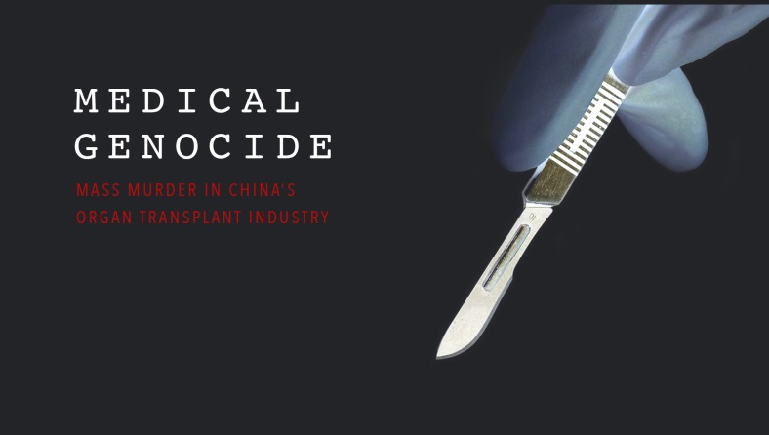
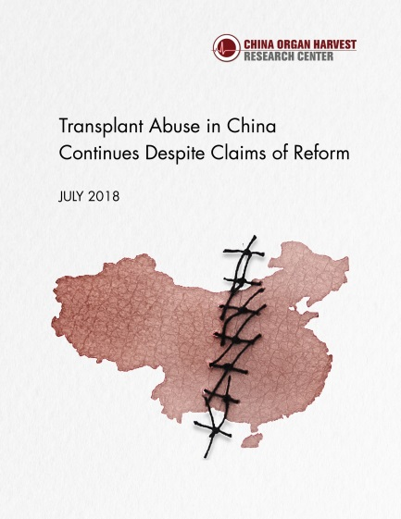
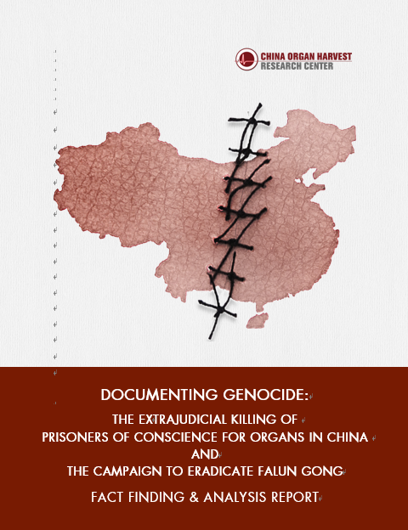
COHRC Reports
2017
2018
2019
Investigative documentary
The full picture of China’s organ transplant industry
implementation of donation system
new developments
victims
testimonies
application to law
Notes:
We finished the research for a 680-page report published in 2016, which was cited by major media outlets around the world. After that, we formally founded the China Organ Harvest Research Center with the hope to deepen and broaden the research to help end China’s organ abuses.
In 2017, to increase the accessibility of the long report, we produced an investigative documentary film which drew a full picture of China’s organ transplantation system.
We then continued to unearth the facts and strengthen the body of evidence we built during the past decade.
After the Chinese regime started claiming in 2015 that it entirely transitioned from sourcing death-row prisoners’ organs to voluntary donations, we spent more than two years digging into how its organ donation system was implemented. In July 2018, we released a new 337-page report at the annual conference of The Transplantation Society. The report was titled “Transplant Abuse Continues in China Despite Claims of Reform,” and you can find it on our website at ChinaOrganHarvest.org.
Then we continued to explore the victims and driving forces of China’s illicit organ harvesting. When all the facts and evidence are put together, it became clear that the Chinese Communist Party’s campaign to eradicate Falun Gong, which has lasted for 20 years, is the background of China’s organ crimes and fully fulfills the criteria for a genocide and a crime against humanity.
This new 2019 report includes a summary of our previous findings and recent developments in China’s transplant system since 2016. It also includes testimonies of relatives of suspected organ harvesting victims and other missing persons, as well as survivors who were detained and tortured in China for their religious beliefs. We also apply the facts to international law.
We provide this report to facilitate policymakers to develop an effective response to these state-driven crimes, to support justice and ensure accountability.

Slide 4
Abrupt Increase Without
Organ Donation System
Since 2000, the PRC government prioritized organ transplantation in national strategy and Five-Year Plans with no voluntary donation system
Led by heavy investment in research and industrialization, China’s transplant system has grown exponentially and become the most prolific in the world in several years.
    150 centers in 1999 ➔ 570 centers in 2004 ➔ 1,000 + centers in 2007
    Transplant volume increased 30-fold between 1999 and 2005
Notes:
Now we begin looking at China’s organ transplantation system.
Starting in 2000, the PRC government has prioritized organ transplantation in its national strategy and Five-Year Plans with no attention given to a voluntary donation system. With heavy investments in organ transplant research and industrialization, China’s transplant system grew exponentially and became the most prolific in the world in the next few years, despite the lack of an organ donation system. The number of transplant centers also ballooned.

Slide 5
On-Demand Transplants
  Transplant operations scheduled in advance
  Organs procured from living sources
  Short wait times
“We will continue to perform transplants until one is successful and will not charge for the repeat surgeries in case of failure ...”
—Kunming Kidney Disease Hospital, advertising “donors seeking matched recipients”
Notes:
We will highlight some key aspects of this industry: its nature, scale, and organ sources.
First, let’s look at its nature. As we know, organ transplants around the world are conducted only as donors become available, but in China, with few donations, vital organs can be made available as needed. This hospital even advertised on its website that it had “donors seeking matched recipients.”
The on-demand nature of China’s organ transplants has three characteristics:
transplant operations scheduled in advance
organs procured from living sources
short wait times

Slide 6
Characteristics
Scheduled in Advance
2005: An Israeli patient traveled to China for a heart transplant scheduled two weeks ahead of time
2013: A hospital performed 4 heart transplants simultaneously in one afternoon
Hospitals are on record performing 10, 20, or even more transplants in a single day, that are sometimes carried out concurrently
Notes:
An Israeli transplant expert reported that one his patients went to China for a heart transplant scheduled two weeks ahead of time.
This remained the case even after China announced its transition to voluntary donations, a source less readily available than death-row executions.
We found that in 2013, a hospital performed 4 heart transplants simultaneously in one afternoon. Hospitals are on record performing 10, 20, or even more transplants in a single day, sometimes carried out concurrently.
All such procedures suggest that the Chinese transplant system can guarantee not only a donor’s death but also the time of his/her death. This would have required not only advance planning but also a nationwide infrastructure of organ procurement networks.

Slide 7
Characteristics:
Organs Procured from Living Sources
“In China, we carry out living donor kidney transplants. It is completely different from the cadaveric kidney transplants you hear about in Japanese hospitals and dialysis centers.”
— China Medical University’s China International Transplantation Network Assistance Center (2004)
In 2004, 64 living kidney donations
As of 2005, living donations accounted for only 1.5% of all kidney transplants; 73 living liver donations
Notes:
A core ethical principle in transplantation of vital organs is the “dead donor rule,” which stipulates that organ donors must be dead prior to procurement and that the procurement itself must not cause the death of the donor. However, evidence shows that many organs were excised in China from living people who were then killed in the process.
China International Transplantation Network Assistance Center (CITNAC) said on its website: “In China, we carry out living donor kidney transplants …” This was said when China had no organ donation system.
In 2004, there were only 64 living kidney donations. As of 2005, living donations accounted for only about 1.5% of all kidney transplants, and there had been only 73 living liver donations.
In the 34 years between 1972 and 2006, there were only 700 living donor kidney transplants in total in all of China.

Slide 8
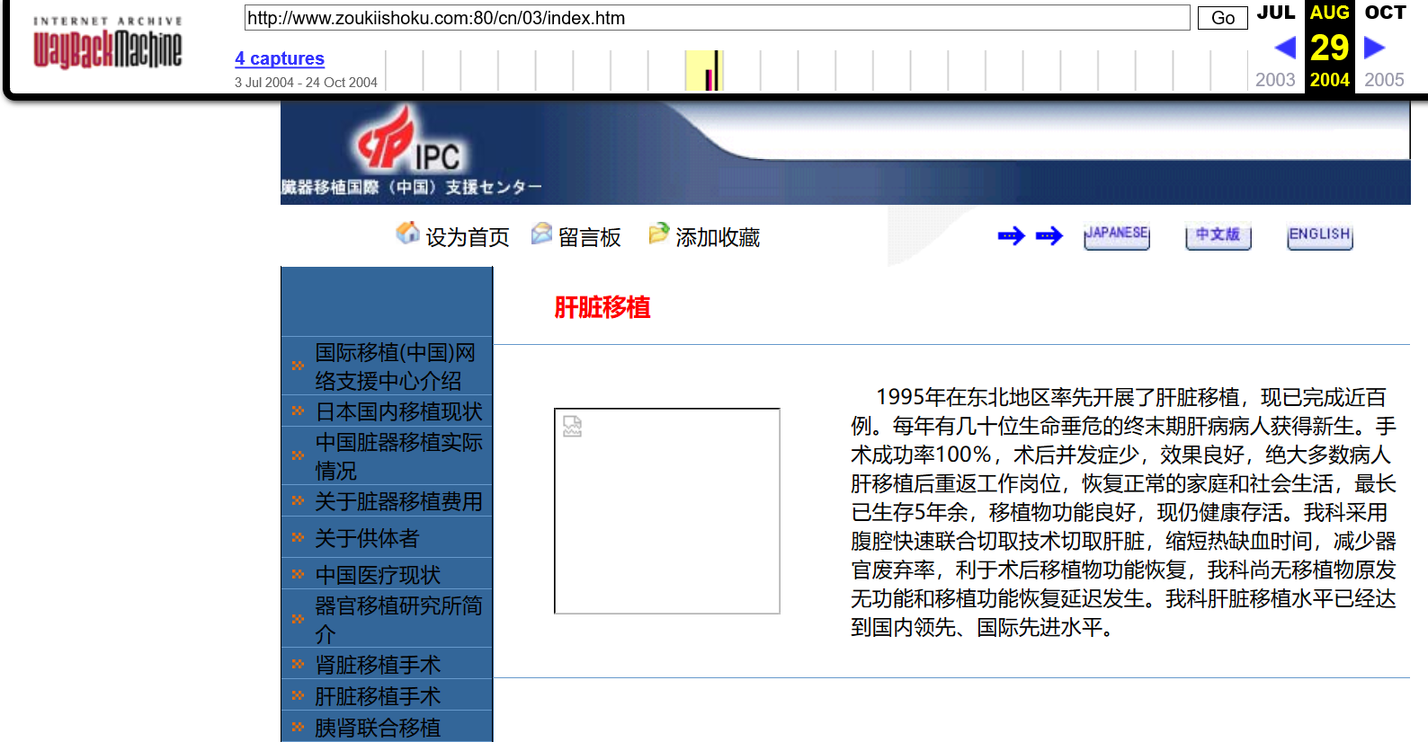
Liver extraction procedures with warm ischemia times (WITs) of 0-5 minutes had become an industry standard, well before China piloted its organ donation system
Medical papers published in China cited 0-10 min WITs
Most liver transplants in China were whole liver instead of partial liver transplants
Without organ donation system, such organs could only be obtained if organs were procured from living people, who were killed during organ procurement
Liver Transplant: Our department adopts peritoneal quick combined cutting technique to cut the liver, shorten the time of warm ischemia, reduce the rate of organ rejection, and facilitate the recovery of graft function …
Screenshot: China International Transplantation Network Assistance Center (2004)
Notes:
In the same period, Chinese surgeons developed liver extraction procedures with warm ischemia times (WITs) of under five minutes, which has since become an industry standard. Medical papers published in China also cited 0-10 min WITs.
Such short WITs could only be obtained if organs were procured from living people.
Unlike in other countries, most liver transplants in China were whole liver instead of partial liver transplants. CITNAC even adopted a rapid liver procurement technique that involves excising all abdominal organs simultaneously, which can reduce both damage to the liver and warm ischemia time. This technique is widely used in China’s transplant centers. This is the screenshot of CITNAC’s website.
Without an organ donation system, such organs could only be obtained if they were procured from living people, who were killed only as a result of the organ procurement process.

Slide 9
Characteristics:
Short Wait Times
2006 China Liver Transplant Registry report: more than 25% of liver transplant cases were emergency transplants for patients who required a transplant operation within 72 hours
2003-2006, Shanghai Changzheng Hospital claimed to perform 120 emergency liver transplants
In October 2017, a hospital quoted wait times of just days or weeks, with patients receiving expedited surgeries if additional monetary "donations" were made
Notes:
Since 2000, hospitals have quoted wait times between days and weeks, including for re-transplants in case of failure, while the wait time is years in other countries.
The China Liver Transplant Registry reported in 2006 that more than 25% of liver transplant cases were emergency transplants for patients who required a transplant operation within 72 hours. For example, between 2003 and 2006, Shanghai Changzheng Hospital performed 120 emergency liver transplants.

Slide 10
Volume Scenario
Liver and Kidney Transplant Capacity of the 146 Approved Hospitals
Based on the Ministry of Health’s Minimum Transplant Bed Count Requirements
Permit Type | Minimum Beds (1) | Annual Transplants (2) | Hospitals (3) | Annual Subtotal (4) | Years (5) | Total Transplants (6)
Liver | 25 | 300 | 21 | 6,300 | 15 | 94,500
Kidney | 30 | 360 | 65 | 23,400 | 15 | 351,000
Liver & Kidney | 55 | 660 | 60 | 39,600 | 15 | 594,000
Total |  |  | 146 | 69,300 |  | 1,039,500
(2) = (1) * 12 (one month hospitalization period) (4) = (2) * (3) (6) = (4) * (5)
Notes:
Secondly, let’s explore the scale of this industry.
As we said, the number of transplants conducted in China is a state secret, and the true number might never be known. However, we have found helpful clues from government regulations and policies. For example, in 2006, the Ministry of Health set these minimum bed counts for the transplant centers to maintain their qualifications. Among the approved transplant hospitals, 146 conducted liver and kidney transplants. This table is only a subset of the 164 approved transplant hospitals (for all organs).
Now if we take these minimum bed counts and calculate the number of transplants that could be done per hospital, even by a one-month hospitalization period and 100% bed utilization rate, then multiply that by the number of approved hospitals, we get the minimum system capacity of about 70,000 liver and kidney transplants per year. Over the course of 15 years, we’re looking at over a million transplants.
Of course, we have to keep in mind that this is the capacity of those hospitals, not the number of transplants actually performed. We found that the vast majority of hospitals far exceed these minimum requirements. Some have hundreds of beds dedicated to organ transplantation with bed utilization rates between 100% and 200%. In addition, there were more than 1,000 transplant hospitals in China in 2007, and many unapproved centers also continued to perform transplants. Therefore, the actual number of transplants performed yearly in China is likely to be much higher than this minimum system capacity.

Slide 11
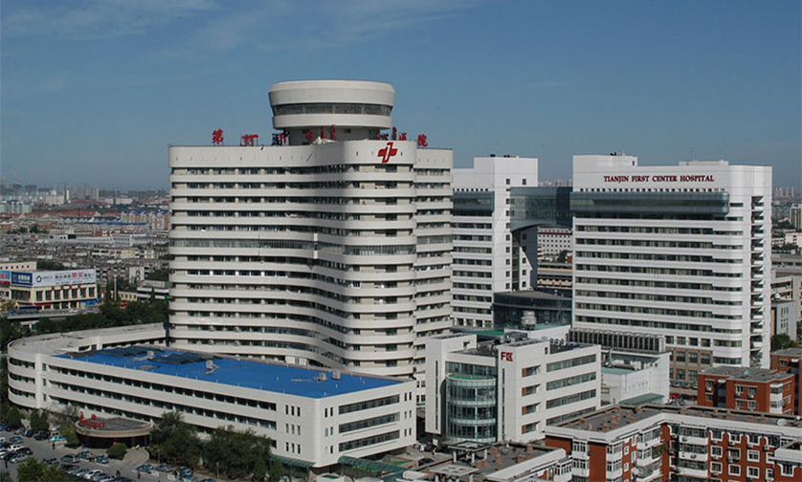
Scale: Case Studies
Tianjin Oriental Organ Transplant Center
The new building opened with 500 dedicated transplant beds in 2006.
Bed utilization rate: 90% in 2009, 131% in 2013 before more beds were added.
With 500 beds, 100% utilization rate, and an average hospitalization time of 3 to 4 weeks, it could have performed 6,000 to 8,000 transplants per year.
2017 onsite investigation shows further expansion on its dedicated international transplant wards
China officially claimed between 10,000 to 15,000 transplants per year
The U.S. averaged 6,000 to 8,000 liver transplants per year in the same period
Notes:
Here are a few examples to give you a sense of how many transplants are performed in China.
The Oriental Organ Transplant Center in Tianjin opened in 2006 with 500 dedicated transplant beds. Its bed utilization reached 90% in 2009 and 131% in 2013 before more beds were added. Even with 500 beds, a 100% utilization rate, and an average hospitalization time of 3 to 4 weeks, its transplant volume could have reached 6,000 to 8,000 per year.
In October 2017, a group of Korean journalists visited this transplant center, where they observed this center housing foreign patients in a nearby hotel in addition to its own facilities, which includes three dedicated international transplant wards. These findings suggest that the center continues to perform thousands of transplants per year.
China officially claims between 10,000 and 15,000 transplants per year, but this figure is surpassed by just a handful of hospitals. As a side comparison, the United States only performed an average of 6,000-8,000 liver transplants in the entire country each year in the past two decades.

Slide 12

Scale: Case Studies
Dongfeng Hospital
“Kidney transplantation is now a routine surgery. Almost all surgeons at our hospital can independently complete kidney transplants.”
—Yuan Fangjun, hospital vice president
10 surgical departments with 100+ surgeons
In 2000: conducted 10 kidney and 3 corneal transplants in one day
Notes:
This push for high transplant volume is not limited to the big, national-level hospitals in big cities. It’s become a major business activity for municipal hospitals and hospitals of big companies as well.
One example is Dongfeng General Hospital, which is affiliated with an automobile company in Shiyan, which is a small industrial city in China. As early as August 2000, in one day it did 10 kidney transplants. The hospital’s vice president said in 2009, “Almost all surgeons at our hospital can independently complete kidney transplants.” They had more than 100 surgeons at that point. We had to ask ourselves how many transplants this hospital was doing to necessitate training almost all its surgeons in this procedure.
These are just the tip of the iceberg. The total number adds up quite quickly once we look at the big picture.

Slide 13
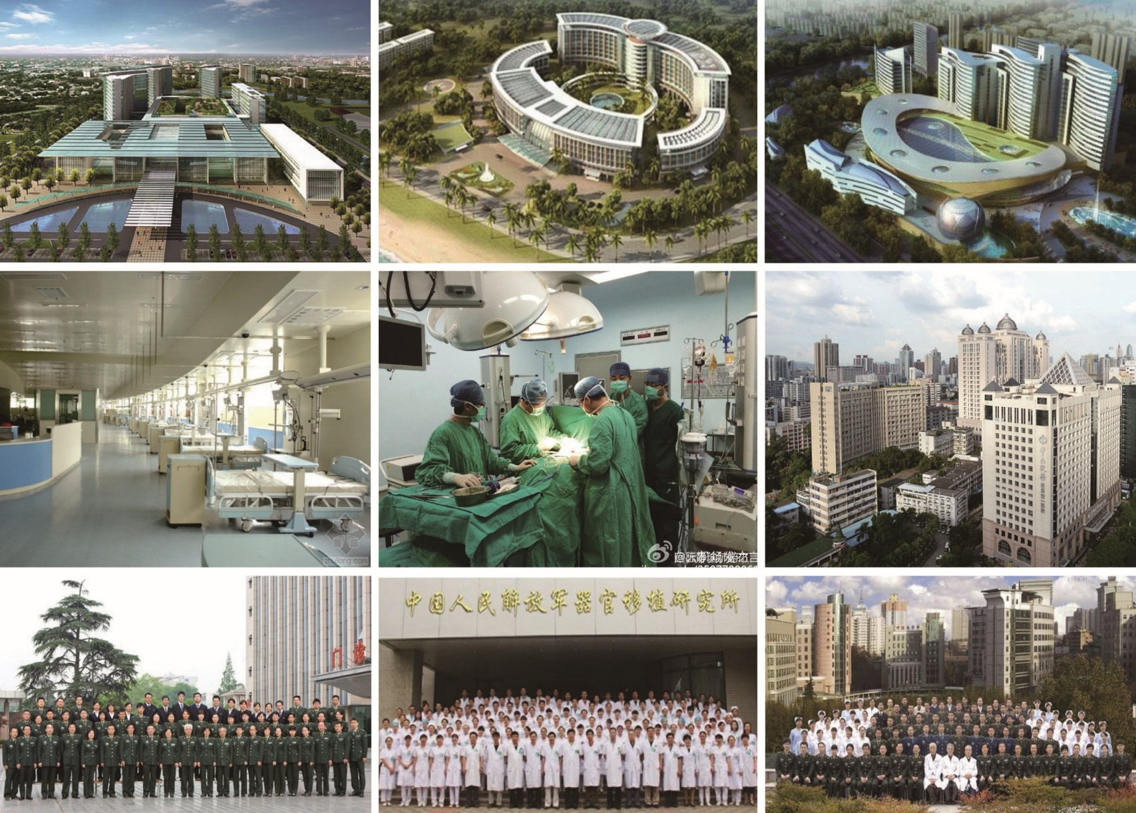
Ongoing Expansion
Increase from 169 approved transplant centers to 300 or 500 in the next few years
Notes:
There is enormous demand for transplants in China.
From what we’ve seen, many transplant centers have had bed utilization rates of 100-200%. Transplant centers have expanded significantly with more beds and new wards, wings, and buildings.
Huang Jiefu, China’s top transplant official, attributed the limiting factor not to organ availability but rather to a lack of qualified hospitals and experienced doctors. He announced plans in 2015 to increase the number of approved transplant hospitals from 169 to 300 and even to 500 over the next few years. This is part of the development roadmap.
As with all businesses, investments are made based on the expectation of profit. The massive expansion and growth of organ transplant centers in China indicates a confidence that there will be an abundant supply of organs well into the future.

Slide 14
Organ Donation Reform
– An Assessment
Chinese Government Claims of Overnight Transition to Ethical Organ Sourcing
Before 2010
2010-2015
2015 to present
No organ donation system
Almost complete reliance on death-row prisoners and prisoners of conscience
2010: first pilot organ donation system implemented
2013: national donation system started, 23% of organs said to be donated
2014: 80% of organs said to be donated
Jan 2015: 100% of organs said to be donated
End of 2017: China’s claim of having 373,536 registered donors could only justify a dozen of actual organ donations.
The sum of reported donation numbers (mainly from non-registered donors in ICUs) in each region could not have covered even the official number of 15,000 transplants performed.
Before 2010
Notes:
Because of a longstanding cultural taboo and a lack of public trust in the medical system, voluntary organ donations are rare in China.
China didn’t start piloting an organ donation system until 2010, when death-row prisoner organs became “a stream without a source.” In 2013, two years after the national donation system started, 23% of organs were said to be donated. In 2014, 80% were said to be donated, and in January 2015, 100% were said to be donated.
However, the fact is that in 2013, the Red Cross stated that China had completed 207 donations. Considering that there were more than 169 approved transplant hospitals at the time, this was equivalent to an average of fewer than one donation per hospital per year.
It is implausible for China to have replaced organ procurement from death-row prisoners with voluntary donations within one year - 2014.

Slide 15
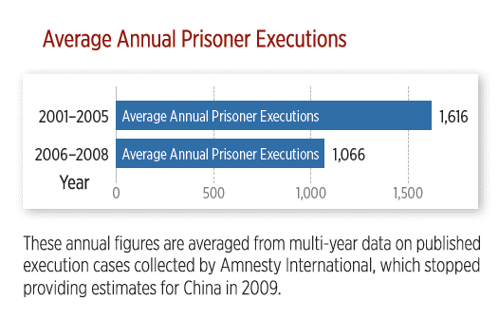
Death-Row Executions
Number treated as
state secret
Estimated 10,000
in year 2000 and
decreasing
Notes:
Now let’s look at death-row executions.
It’s hard to get specific figures for this because it’s treated as a state secret in China. What we do know is that estimates by international organizations have put it at around 10,000 per year in the year 2000, and there’s been a decreasing trend since then. This organ source could not have supported China’s ever-expanding transplant industry.
The Chinese regime has admitted to using organs from death-row prisoners, a relatively less severe abuse, to divert attention from the more severe issue, using innocent people whose only “crime” is their religious or political beliefs.

Slide 16

Donation System Used to Launder Organs
❍ Current regulations embed loopholes for illicit organ sourcing
China has not enacted fundamental laws that recognize brain death or govern organ sourcing, donation, procurement, allocation, and transplantation.
“China currently has a voluntary organ donation rate from living relatives of 1.1%. Over 98% of organ sources is controlled outside the Ministry of Health system.”
―Sanlian Life Weekly (2006)
“The departmental regulations, administrative policies and guidelines can only impose administrative penalties on the offender (up to a license revocation), and there is no criminal or civil liability; these rules are not enforceable in legal or penal systems—more organ sources come from them [than from the medical system].”
―Chen Zhonghua, a pioneer of organ donation (2006)
Notes:
When death-row prisoners’ organs became “a stream without a source,” China announced that it would pilot a voluntary organ donation system in 2010. However, China has not enacted fundamental laws recognizing brain death or governing organ sourcing, donation, procurement, allocation, and transplantation till now.
In 2008, Li Leishi, academician at the Chinese Academy of Engineering, told the media, “In China, organ donation after a citizen’s death exists [only] in theory.”

Slide 17
Donation System Used to Launder Organs
Donation system remains an empty shell
“The administration of organ donation and transplantation for 1.3 billion people is a big project, but right now there’s only one person.”
—Huang Jiefu, Chairman of the National Organ
Donation and Transplantation Committee (2017)
❍ Opaque operations
China’s Organ Procurement Organizations operate without oversight and are run by the same surgeons who are involved in unethical organ procurement and transplantation.
“Organ resources – all recipients and donors, the entire chain of organ transplantation – are in the hospitals.”
—Huang Jiefu (2013)
Notes:
The situation remains. Our findings show that the heavily publicized donation and allocation system, including COTRS, serves as a façade used to whitewash illicit organ sources. It does not function in practice or contribute significantly to the actual scale of transplants performed in China.

Slide 18
Donation System Used to Launder Organs
❍ Widespread Abuse of Brain Death Determination
“Among China’s donations so far, 70% are from brain-dead donors. Of the other 30%, many are from brain and cardiac death.”
“It’s impossible to include brain death in organ donation regulations. Most doctors don’t know how brain death works, very few truly understand the standards for brain death. Legislating brain death may not happen in another 20 years.
―Huang Jiefu, Chairman of the National Organ Donation
and Transplantation Committee (2017)
Notes:
Huang Jiefu said in 2017 that 70% of organs came from brain-dead donors; the other 30% were mainly from donation after brain death followed by cardiac death (DBCD). However, most of doctors in China were unaware of a standard procedure to determine brain death as of 2017. This contradiction suggests widespread abuse of brain death determination in China.

Slide 19
A Statistical Farce
Organ donation as of 2017 | USA | China
Registered as organ donors | 138,000,000 | 373,536
Deceased registered donors | 4,700 | 12.7
Deceased non-registered donors | 5,500 | 5000 (claimed)
Total deceased donors | 10,200 | 5,146 (claimed)
Total organ transplants from deceased donors | 28,500 | 14,190 (claimed)
Total organ transplants | 35,582 | 16,687 (claimed)
Median wait time (kidney) | 3.6 years | Days to weeks?
Notes:
The U.S. had 130 million registered organ donors in 2016. With a crude annual death rate of 8.2 per 1000 population, there would have been an estimated 1.07 million deaths of registered donors. There were 9,971 deceased organ donors.
China had 104,538 registered organ donors in 2016 and a death rate of 7.7 per 1000 population, which would yield an estimated 805 deaths of registered donors.
Even if its ratio of registered donor deaths and actual donors is similar to that of the U.S, this figure would translate to 7.5 donors.
Even CODAC’s figure of 373,536 registered donors at the end of 2017 would yield proportionally a dozen actual donors.
But China claims that 100% of organs are donated and routinely quotes waiting times in days to weeks. How is this possible?

Slide 20
Number of Donors in Top Provinces
Province | As Of | Total donors (All Time) | Average donors per year (Assuming All Occurred In Prior 3 Years) | Number of Approved Transplant Hospitals | Avg Donors Per Hospital Per Year
Guangdong | June 2017 | 2152 | 717 | 18 | 40
Hubei | Mar 2018 | 1625 | 542 | 7 | 77
Shandong | Dec 2017 | 1478 | 493 | 13 | 38
Zhejiang | Jul 2017 | 730 | 243 | 7 | 35
Sichuan | Nov 2017 | 424 | 141 | 4 | 35
Shanghai | Sep 2017 | 400 | 133 | 11 | 12
Liaoning | Oct 2017 | 245 | 82 | 6 | 14
Hebei | Apr 2018 | 230 | 77 | 3 | 26
Yunnan | Apr 2017 | 187 | 62 | 5 | 12
Anhui | Apr 2018 | 124 | 41 | 2 | 21
Heilongjiang | Apr 2018 | 55 | 18 | 2 | 9
In. Mongolia | May 2018 | 34 | 11 | 2 | 6
Notes:
Let’s look at the scale from another angle, the actual donations by regions.
The average reported donors per transplant hospital for the top provinces were just dozens each year. They could not accommodate even China’s minimum government-imposed transplant system capacity (based on minimum bed counts) in one year, let alone its on-demand nature and the number of actual transplants conducted.

Slide 21
Study Casts Doubt on
China's Organ Donation Data
China’s reported organ donation numbers don't stack up.
There is highly compelling evidence that they are being falsified: The figures appear to have been based on a quadratic function.
The study has been reviewed by a leading statistician: “The close agreement of the numbers of donors and transplants with a quadratic function is remarkable and is in sharp contrast to other countries who have increased their activity over this period...”
“The Chinese government may have been systematically misreporting the number of organs it claims it has voluntarily collected since 2010.”
―A new study published in BMC Medical Ethics in Nov 2019
Notes:
Furthermore, according to new research published in BMC Medical Ethics in November 2019, the Chinese government may have been systematically misreporting the number of organs it claims it has voluntarily collected since 2010.
https://bmcmedethics.biomedcentral.com/articles/10.1186/s12910-019-0406-6
Robertson, M.P., Hinde, R.L. & Lavee, J. Analysis of official deceased organ donation data casts doubt on the credibility of China’s organ transplant reform. BMC Med Ethics 20, 79 (2019) doi:10.1186/s12910-019-0406-6
The researchers' findings have been reviewed by one of the world's leading statisticians, Sir David Spiegelhalter, former president of the Royal Statistical Society in the UK:
"The anomalies in the data examined...follow a systematic and surprising pattern," Spiegelhalter wrote, "The close agreement of the numbers of donors and transplants with a quadratic function is remarkable and is in sharp contrast to other countries who have increased their activity over this period... I cannot think of any good reason for such a quadratic trend arising naturally."

Slide 22
Global Expansion
“The future transplant costs in China will still be the cheapest and most accessible in the world, and [the transplants will be] of high quality.”
―Huang Jiefu through Peng Pai News in August 2015
Cross-Strait Organ Exchange w/ Taiwan (2014)
Organ sharing agreements with Macau, Hong Kong, and Taiwan (Nov 2017)
One Belt, One Road (2017)
Notes:
Even though the sparse organ donations cannot even cover domestic needs, in 2014, Huang Jiefu went to Taiwan to propose a "cross-strait organ exchange platform" effectively to export human organs from the mainland to Taiwan, such that “patients would no longer need to travel from Taiwan to mainland China to undergo transplants.”
The China Organ Transplantation Development Foundation (COTDF) signed an organ sharing agreement with the Macau Health Bureau in November 2017. Residents of Macau, Hong Kong, and Taiwan can register for organs through COTRS, China’s new organ allocation system.
At the 2017 Chinese Transplant Conference, Huang Jiefu presented organ transplantation as part of China’s “One Belt, One Road” Initiative. The Initiative aims to strengthen cooperation in organ transplantation between China and other parts of Asia, Europe, East Africa, and Oceania.

Slide 23
Organ Tourism
China has become the organ transplant centre of the world
Tens of thousands of foreign patients flock to China for organs, including from South Korea, Japan, Malaysia, Egypt, Pakistan, India, Saudi Arabia, Hong Kong, Macao, Taiwan, Australia, Europe, and North America
In 2006, 85% of transplant patients at the Tianjin First Centre Hospital came from 20+ foreign countries and regions
After China’s organ crimes came to light, the Ministry of Health issued a ban on organ tourism to China in 2007
In 2016, Huang Jiefu stated both in China and abroad, “China strictly limits organ tourism. There has not been a single foreigner coming to China for transplant tourism.”

Slide 24
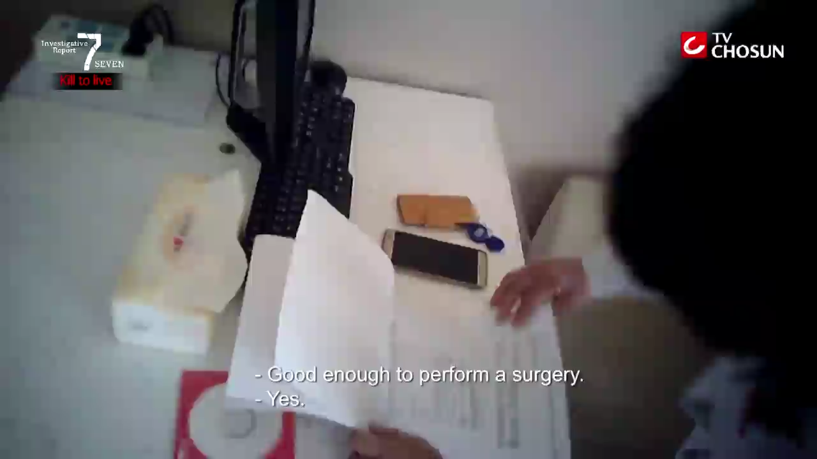

Recent Investigations Confirm
Ongoing Organ Tourism to China is Thriving
BBC investigation in 2018
Matthew Hill was told by a hospital in Guangzhou
that he could have a liver transplant within weeks.
October 2017 South Korean TV Journalists On-Site Investigation into a Tianjin Hospital
Hidden camera footage Tianjin Hospital
Notes:
However, recent Investigations confirm that organ tourism to China continues to thrive:
An on-site investigation by South Korea’s TV Chosun in 2017 showed a steady stream of international patients receiving organs at one of the largest transplant centers in China:
dedicated facilities and staff for international patients
high volume: 8 transplants on a single day in the international department
contradicts official statements that transplant tourism no longer occurs:
“The government pretends not to know about it”
“We have lots of foreign patients”
wait times: days to weeks (on demand)

Slide 25
Victims
Historical Practices
Notes:
It seems that China has more than enough organs to export, despite few donations. Where do the organs come from?
In fact, using prisoners’ organs is not a new thing. Documents dating from 1962 show that the Central Military Commission issued guidance that all death-row and serious offenders can be disposed of according to the Party’s needs per “revolutionary protocol,” under which enemies of the state are deprived of all rights and utilized as state resources.
Early 1940s: “counter-revolutionaries” killed for cadavers
1960: China performs first organ transplant
1962: Central Military Commission issues guidance that all death-row and serious offenders can be disposed of according to the Party’s needs per “revolutionary protocol”
1978 - First documented organ harvesting from a prisoner of conscience, Zhong Haiyuan

Slide 26
Role of the State
“Being able to complete such a number of organ transplant operations is inseparable from the government’s support. The Chinese government’s Supreme People's Court, Supreme People's Procuratorate, Public Security system, judicial system, Ministry of Health, and Ministry of Civil Affairs jointly promulgated regulation on October 9, 1984 and established that organ procurement would be an activity supported by the government. This is a one of a kind in the world.”
Notes:
A major transplant center thanked the government for supporting its organ procurement activities. This refers to a regulation passed in 1984 that allows the bodies and organs of prisoners to be used under certain conditions.
During the persecution of Falun Gong, this regulation justifies the sourcing of organs from Falun Gong practitioners who refuse to disclose their identities without consent of either themselves or their family members, even though they have not been sentenced to death.
Huang Jiefu’s announcement about stopping the use of organs from death-row prisoners has no legal effect and cannot be traced to any official policy statements or laws. Organ harvesting is still supported and protected by the government today.

Slide 27
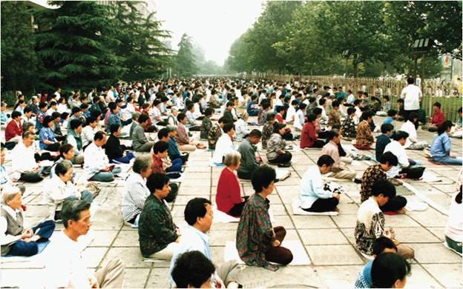
Main Victims After 2000
Falun Gong: a traditional self-cultivation practice
No religious formality or membership structure
Freely taught around the world
Estimated 70 million practitioners in 1999 before crackdown
Notes:
Since 2000, those targeted for organ harvesting have primarily been practitioners of Falun Gong, a traditional meditation practice whose adherents seek to cultivate the qualities of truthfulness, compassion, and tolerance. It has no religious formalities or membership structure, and it is freely taught around the world.
By the end of the 1990s, over 70 million Chinese citizens were practicing Falun Gong.

Slide 28

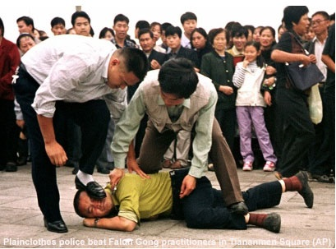
Eradication Campaign
Chinese Communist Party banned Falun Gong in 1999 in violation of the Constitution
Directives: “Crush them politically, cut them off financially, and destroy their reputation”
100% “transformation” without exemption
“Deaths of Falun Gong practitioners from beating are nothing and shall be counted as suicide; the bodies shall be directly cremated without investigating the person’s identification.”
In 2001, the campaign against Falun Gong was included in China's Tenth Five-Year Plan
Meanwhile, organ transplantation has been prioritized in China’s national development strategy without a voluntary organ donation system
Notes:
The Communist Party’s former leader Jiang Zemin saw Falun Gong’s popularity as a threat to his rule. In violation of the Chinese Constitution, Jiang launched a campaign in 1999 to ruin their reputations, bankrupt them financially, and destroy them physically. Under the instruction of 100% “transformation” without exemption, Falun Gong practitioners have been systematically arrested and tortured in prisons, labor camps, and secret detention facilities for refusing to renounce their faith.
In 2001, the campaign against Falun Gong was included in China's Tenth Five-Year Plan. Meanwhile, organ transplantation has been prioritized in China’s national development strategy without a voluntary organ donation system.

Slide 29
Dehumanization of Victims
“Opposing Falun Gong is a grave political struggle. We must not be softhearted when dealing with a little group of hardcore reactionaries.” —Huang Jiefu (2001)
“Anybody, if they label themselves [anything] other than communist, or Communist Party member, then they will be treated as an enemy of the state. Therefore, they are not even qualified as human beings. Therefore, they are subject to whatever punishment is available.” —Enver Tohti, a former Uyghur surgeon
“All the livers are directly extracted at the source … We don’t care whether it’s from a Falun Gong practitioner or not. We don’t get involved in politics. As doctors, we only care about the donor liver, about whether it meets the requirements of transplantation. If it meets the requirements, we don’t care who it’s from.”
— Tan Yunshan, Director, Liver Disease Department, Zhongshan Hospital, Fudan University
Notes:
When the regime faces practitioners who refuse to “transform” under torture, it uses physical destruction as the last method to achieve its desired “100% conversion rate.”
The physical destruction has been carried out through the Chinese law enforcement system by torturing Falun Gong practitioners to death and killing them through the administration of nerve, organ, and/or brain-damaging drugs. It has also been carried out through the Chinese medical system by harvesting the organs of Falun Gong practitioners to supply the organ transplant industry.
Officials in China’s organ transplantation system also actively implemented this campaign by publishing anti-Falun Gong propaganda. For example, Huang Jiefu, the de facto person in charge of organ transplantation, actively incited hatred of Falun Gong in earlier years by propagating the Party’s rhetoric against the group in the medical community.
Enver Tohti, a former Uyghur surgeon who was told to extract organs from a living prisoner, explains in his testimony the indoctrination techniques that have enabled doctors to rationalize harvesting organs from living people.

Slide 30
Primary Victims
Falun Gong: 70 million when the persecution started in 1999
  persecution unmatched in scale, sophistication, cruelty and longevity
Uyghurs: 24 million in Xinjiang
  more recent and limited in scope
  more evidence of organ harvesting could emerge over time
Other religious groups, such as Tibetans and House Christians, as well as other prisoners of conscience, dissidents and migrants
The lives and fates of different groups are all intertwined. Risk to one group is risk to all
Notes:
To be clear, we don’t want to discount the impact of such a horrific crime on any particular victim group, but we do see a difference in relative proportions.
From the evidence we have seen, most organs come from Falun Gong practitioners, the largest group openly targeted by the Communist Party. There were more than 70 million Falun Gong practitioners when the persecution started, they are distributed all over the country, and for most of the past 20 years, they were the largest group of prisoners of conscience in China. At least hundreds of state and military hospitals all over China have participated in these illicit transplants.
Relatively speaking, the concerted persecution and targeting of Uyghurs for organ harvesting is more recent and limited in scope, both in number and geographic coverage. More evidence of organ harvesting from this group could emerge over time.
The Party is expanding its targets for reeducation campaigns, surveillance, and organ harvesting to exploit much larger populations across China.

Slide 31
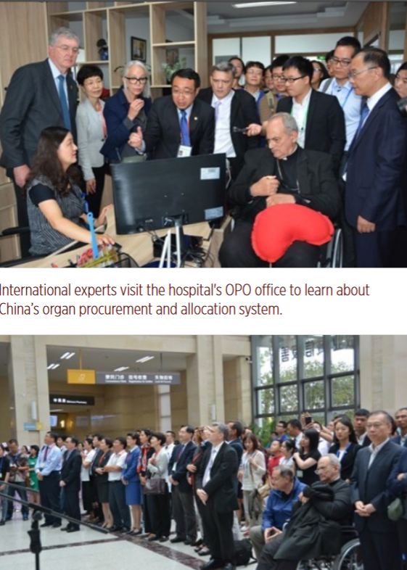
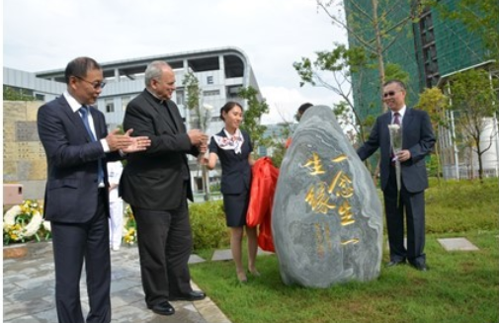
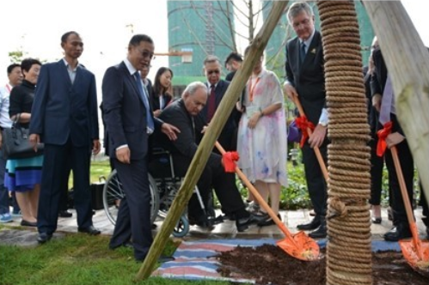
Tours by International Experts
In August 2017, international experts were invited, for the first time, to tour the Calmette International Hospital in Kunming.
In Oct 2016, Calmette performed 16 transplants in a single day.
In Mar 2017, personnel from the Oklahoma Transplant Center in the United States were invited to perform 15 transplants in 24 hours.
Entire Yunnan province averaged only 47 voluntary organ donations per year over the prior four years.
Notes:
Nevertheless, through public relations campaigns using falsified data, presentations of unimplemented plans, and dismissing evidence of state-driven systemic abuse as isolated criminal cases, China’s claimed reform has gained endorsement and even promotion by some international transplant experts.
This was the first time China had opened a transplant hospital to international experts, who were to experience “the Chinese mode” of organ donation and transplantation.
The experts watched as donor organs were transported to the hospital by helicopter and sent to an operating theater through a “green passage.” They visited an Organ Procurement Organization (OPO) office to learn about the hospital’s process of organ procurement, allocation, and transplantation. They also visited a reception area for families of organ donors and equipment storage rooms.
On October 19, 2016, Calmette performed 16 transplants in a single day. Approximately 140 medical personnel directly participated in the surgeries.
In March 2017, Calmette invited personnel from the Oklahoma Transplant Center in the United States to perform 15 transplant surgeries in 24 hours.
While the experts were awed by the showcase of China’s “amazing progress” in organ donation, the entire Yunnan province averaged only 47 voluntary organ donations per year over the prior four years, which could not even supply the organs used by this hospital alone.

Slide 32
Medical Collaboration
Disclaimer: Every person is innocent until proven guilty. Any reference to specific persons or institutions is only made for the purpose of demonstrating a general state of international collaboration, and should not be taken as indications of any wrongdoing or guilt for the persons or institutions concerned.
In 2003, Xi'an Jiaotong University and the Terasaki Laboratory in the United States jointly established the Organ Transplant Tissue Typing Technology Training Center in northwestern China. By December 2012, this center had trained more than 500 medical professionals from other domestic institutions.
In June 2006, the China Medical Board (CMB) in New York took part in providing one million USD to assist China in the establishment three liver transplant training centers: the Peking Union Medical College Hospital, the First Affiliated Hospital of Sun Yat-sen University, and Tianjin First Central Hospital. As of 2012, the Oriental Organ Transplant Center at Tianjin First Central Hospital had trained over 385 transplant doctors who then became the core personnel in their departments across the country.
In March 2018, experts of the Liver Transplantation Program at University Medical Center Groningen in the Netherland visited the organ transplant center at the First Affiliated Hospital of Sun Yat-Sen University to study the non-ischemic liver transplant technique and signed a cooperation agreement with the center to expand this technique internationally.
In November 2018, University of Pittsburgh Medical Center (UPMC) signed a 20-year agreement with a $2 billion investment with Wanda Group to build five new hospitals in China. The first Chengdu Wanda-UPMC International Hospital, which broke ground in October 2019 and is scheduled to open in 2022, will serve as a model for the next four major hospitals. UPMC is providing assistance with the hospital’s clinical operations, technology and management, and it will get a percentage of the profits that the Wanda-UPMC hospitals make.
  …
Notes:
Here are some examples demonstrating a general state of the collaboration in the medical field between China’s transplant institutions and international institutions:
https://www.upmc.com/about/international-services/locations/china
https://web.archive.org/web/20191120054715/https://www.upmc.com/about/international-services/locations/china
https://triblive.com/local/pittsburgh-allegheny/upmc-breaks-ground-on-hospital-in-china-4-more-in-the-works/

Slide 33
Global Expansion and
Ethical Implications
“International transplantation is like a boat, and for many years, China was swimming outside of the boat. Now the boat, with China jumping on board, is moving faster than ever before.” “China’s efforts are leading the boat’s way.”
  —José Núñez, Medical Director of the World Health Organization’s organ donation and transplantation program (August 2017 and February 2018)
Notes:
I actually do not challenge the content of this quote. What this man is saying is true.
China is expanding its transplant system outside its borders and seeking to redefine its role as a global leader through organ sharing agreements and other forms of engagement with international institutions, including academic collaboration, commercial transactions, and transplant tourism:
At The Transplantation Society (TTS)’s annual congress in Madrid in July 2018, despite allegations of transplant abuses, 150 Chinese experts took part with their papers and presentations being widely adopted .
445 Chinese organ transplantation research papers have been published in peer-reviewed English-language medical journals between 2000 and 2017.
A 2018 review found that more than 90% failed to meet international ethical standards banning publication of research involving biological material from executed prisoners.
My only question is: where is this boat heading?

Slide 34
Violations of International Law
The United Nations’ Convention on the Prevention and Punishment of the Crime of Genocide (Genocide Convention)
Three United Nations Statutes defining Crimes Against Humanity :
Rome Statute of the International Criminal Court
Updated Statute of the International Criminal Tribunal for the Former Yugoslavia (ICTY)
Statute of the International Criminal Tribunal for Rwanda (ICTR)
1
Genocide
Crimes Against Humanity
2
Notes:
In our 2019 report, we also apply the facts to international laws. All our unearthed facts and evidence show that China’s illicit organ harvesting program is based upon the communist regime’s systematic campaign to eradicate faith groups.
Our legal analysis finds beyond reasonable doubt that the Chinese regime’s eradication campaign against Falun Gong since 1999 has satisfied all the elements that constitute crimes against humanity and genocide.

Slide 35


“The Tribunal’s members are certain - unanimously, and sure beyond reasonable doubt – that forced organ harvesting has been committed for years throughout China on a significant scale; and that Falun Gong practitioners have been one - and probably the main - source of organ supply.
The concerted persecution and medical testing of the Uyghurs is more recent and it may be that evidence of forced organ harvesting of this group may emerge in due course.”
“Governments and any who interact in any substantial way with the PRC should now recognize that they are, to the extent revealed above, interacting with a criminal state.
—China Tribunal, Independent Tribunal into Forced Organ Harvesting from Prisoners of Conscience in China, Summary of Final Judgment, June 17, 2019
Sir Geoffrey Nice QC (Chair)
led the prosecution of Slobodan Milošević, former President of Serbia, at the UN’s International Criminal Tribunal (1998 – 2006)

Slide 36
Legislative Efforts
Against Organ Transplant Abuse Around the World
In December 2013, the European Parliament adopted an emergency resolution 2013/2981(RSP) calling on the Chinese regime “to end immediately the practice of harvesting organs from prisoners of conscience and members of religious and ethnic minority groups.”
In June 2016, the U.S. House of Representatives unanimously passed House Resolution 343 condemning "the systematic, state-sanctioned organ harvesting from non-consenting prisoners of conscience" in China
Israel, Spain, Italy, Taiwan, Norway, and Belgium have passed laws criminalizing organ trafficking and restricting transplant tourism to China
Notes:
Since this crime was first reported in 2006, some governments have passed resolutions and legislation to imposed criminal penalties to restrict illicit organ tourism, as well as resolutions condemning the atrocities.

Slide 37
Proposed Strategies for Legislation and Policy Reform in the U.S.
Proposed strategies include:
Publicly condemn forced organ harvesting in China by issuing a public statement or resolution;
Voice support for legislative measures to criminalize organ trafficking and transplant tourism to China;
Requiring more substantive verification of ethical organ procurement as a requirement for collaboration and business transactions
Expansion of independent investigations into transplant abuse in China, and awareness and education initiatives.
Notes:
The United States is both obligated and well-positioned to enact policies to help end the killing for organs and prevent complicity by international parties.

Slide 38



The wrongs which we seek to condemn and punish have been so calculated, so malignant, and so devastating, that civilization cannot tolerate their being ignored, because it cannot survive their being repeated.”
– Chief American prosecutor Justice Robert Jackson delivers the opening speech of the American prosecution at the International Military Tribunal trial of war criminals at Nuremberg. November 21, 1945
Notes:
As a historical reference, 70 years ago, when Nazi doctors stood trial at Nuremberg after World War II, the chief American prosecutor Robert H. Jackson said, “The wrongs which we seek to condemn and punish have been so calculated, so malignant, and so devastating, that civilization cannot tolerate their being ignored, because it cannot survive their being repeated.”
Unfortunately, such crimes against humanity have been repeated, and it has been happening since the beginning of this century. This requires a response.

