Slide 1


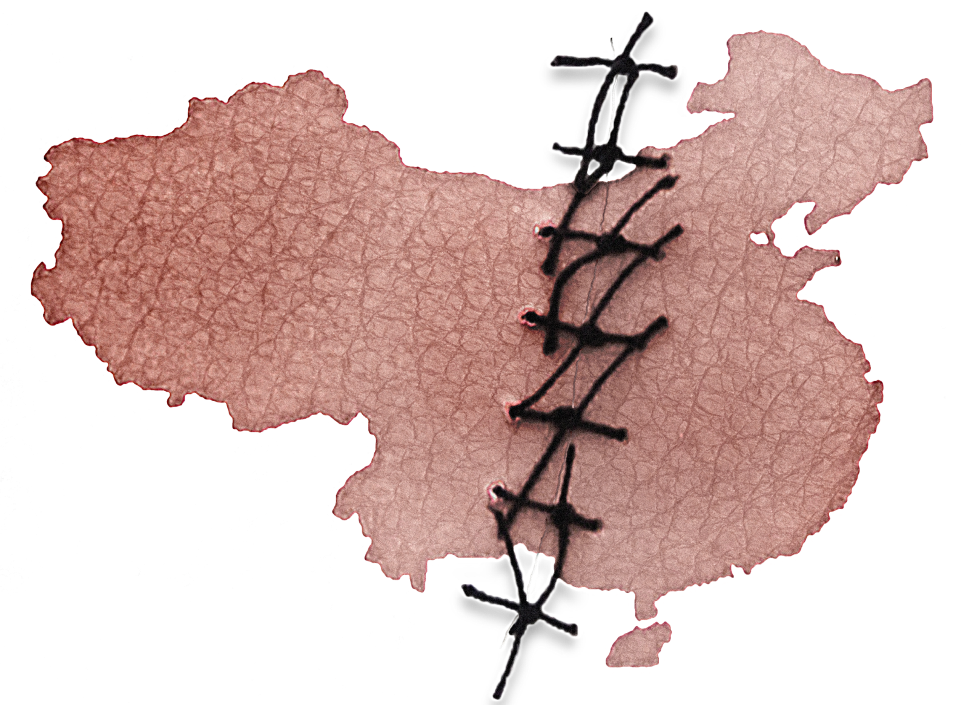
China’s Expanding Organ Transplant Abuse and
Its Implications for International Health Policy
Sample Slides for a
90-Minute Presentation

Slide 2
Agenda
Overview and Video (25 min)
On-Demand Transplants
Organ Sources and New Developments
Victims and Video Testimonies (8 min)
Violations of International Law
Legislative Efforts to Combat the Crimes

Slide 3
1
About COHRC
2
Methodology and data sources
Overview
3
On-Demand Transplants
4
Industrial scale and trajectory
Notes:
In 2006, allegations first came to light that prisoners of conscience were being killed on demand in detention facilities and hospitals throughout China to provide organs for its vast transplantation industry. Since then, international researchers have continued to investigate these allegations.
China Organ Harvest Research Center (COHRC) is a nonprofit organization based in the United States. It conducts and presents the latest research on organ transplant abuse in China, including the killing of prisoners of conscience for organs. While China Organ Harvest Research Center is a relatively new name, our research team has been working on this issue for over a decade.

Slide 4
Methodology
Challenges we faced:
State secret
Evidence has been systematically destroyed
Data falsified level by level
True number unknown
We examined hundreds of hospitals for their:
Qualifications
Revenue
Bed counts and utilization rates
Personnel strength
Patents and awards
Funding
National directives
Regulations and policies
Notes:
Since these crimes are still going on, digging for the true data is very difficult. In fact, the true number of transplants and their sources are treated as a state secret. The evidence has been systematically hidden and destroyed, and data is falsified level by level because of financial incentives and unaccountable organ sources. As a result, the true number of transplants performed in China may never be known.
While it is impossible to directly observe this giant, it is possible to gauge its size by measuring the dimensions of its footprints and understand its characteristics by a study of its habitat. The methodology of our research is very much similar to that in the study of paleontology. We have systematically examined and analyzed hundreds of transplant hospitals, government and industry statements, policies, legislation, regulations, media reports, medical journals, and other information. That formed the foundation of the evidence system of China’s forced organ harvesting.

Slide 5
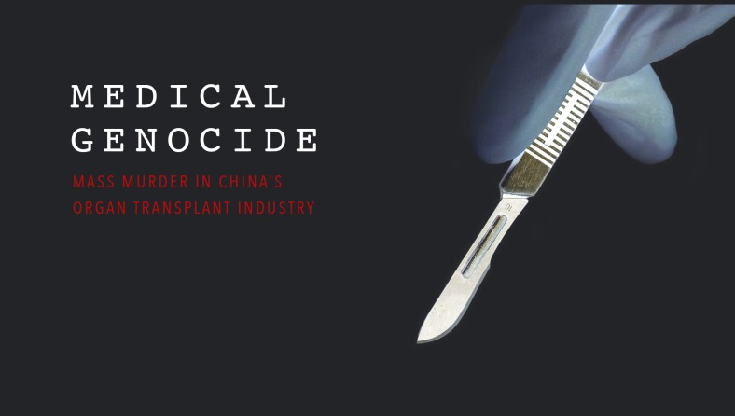
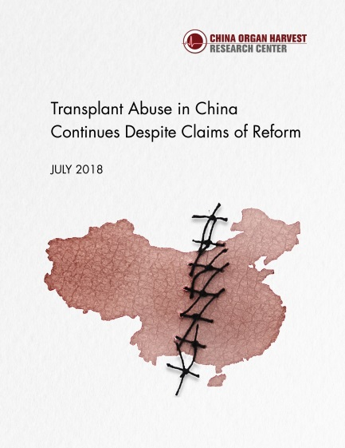
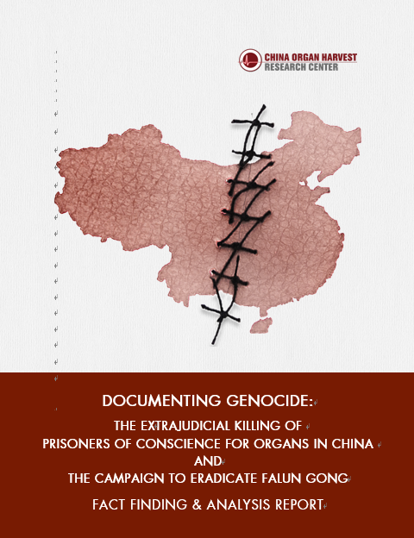
COHRC Reports
2017
2018
2019
Investigative documentary
The full picture of China’s organ transplant industry
implementation of donation system
new developments
victims
testimonies
application to law
Notes:
We finished the research for a 680-page report published in 2016, which was cited by major media outlets around the world. After that, we formally founded the China Organ Harvest Research Center with the hope to deepen and broaden the research to help end China’s organ abuses.
In 2017, to increase the accessibility of the long report, we produced an investigative documentary film which drew a full picture of China’s organ transplantation system.
We then continued to unearth the facts and strengthen the body of evidence we built during the past decade.
After the Chinese regime started claiming in 2015 that it entirely transitioned from sourcing death-row prisoners’ organs to voluntary donations, we spent more than two years digging into how its organ donation system was implemented. In July 2018, we released a new 337-page report at the annual conference of The Transplantation Society. The report was titled “Transplant Abuse Continues in China Despite Claims of Reform,” and you can find it on our website at ChinaOrganHarvest.org.
Then we continued to explore the victims and driving forces of China’s illicit organ harvesting. When all the facts and evidence are put together, it became clear that the Chinese Communist Party’s campaign to eradicate Falun Gong, which has lasted for 20 years, is the background of China’s organ crimes and fully fulfills the criteria for a genocide and a crime against humanity.
This new 2019 report includes a summary of our previous findings and recent developments in China’s transplant system since 2016. It also includes testimonies of relatives of suspected organ harvesting victims and other missing persons, as well as survivors who were detained and tortured in China for their religious beliefs. We also apply the facts to international law.
We provide this report to facilitate policymakers to develop an effective response to these state-driven crimes, to support justice and ensure accountability.

Slide 6
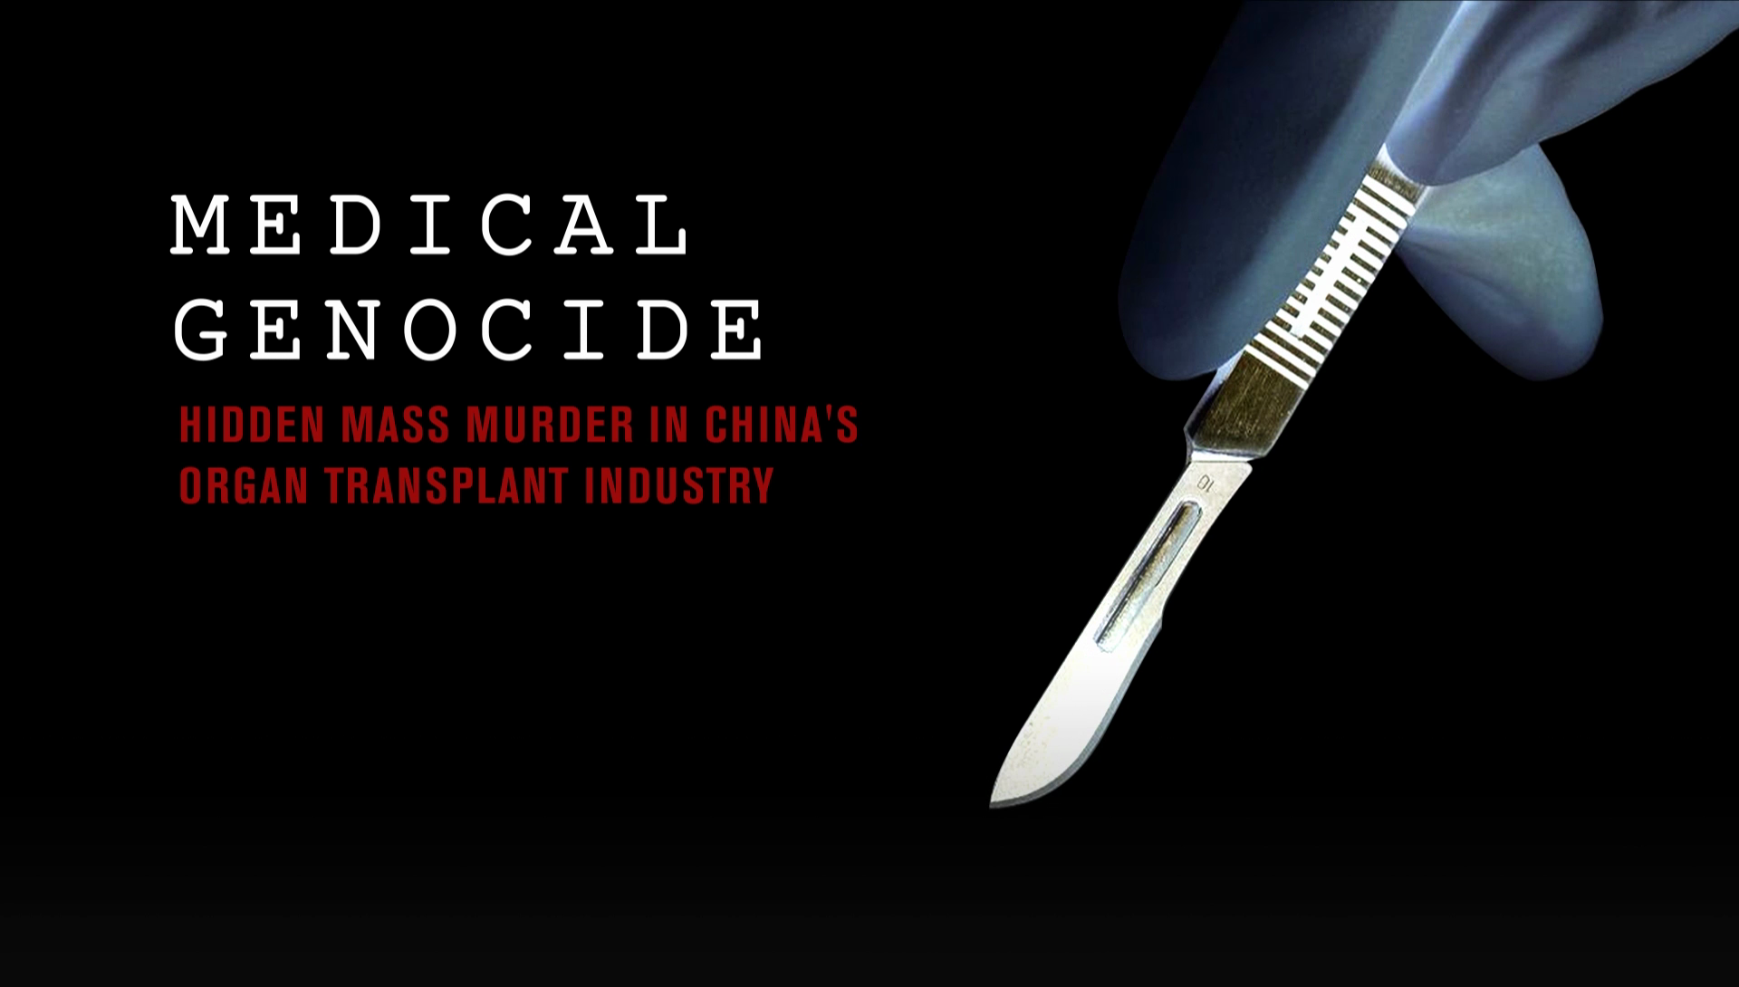
Notes:
Now we’re going to play this documentary film to give a glimpse into the full picture of China’s organ transplantation system.
play video at: https://vimeo.com/207039399

Slide 7
On-Demand Transplants
  Transplant operations scheduled in advance
  Organs procured from living sources
  Short wait times
“We will continue to perform transplants until one is successful and will not charge for the repeat surgeries in case of failure ...”
—Kunming Kidney Disease Hospital, advertising “donors seeking matched recipients”
Notes:
We will highlight some key aspects of this industry: its nature, scale, and organ sources.
First, let’s look at its nature. As we know, organ transplants around the world are conducted only as donors become available, but in China, with few donations, vital organs can be made available as needed. This hospital even advertised on its website that it had “donors seeking matched recipients.”
The on-demand nature of China’s organ transplants has three characteristics:
transplant operations scheduled in advance
organs procured from living sources
short wait times

Slide 8
Characteristics
Scheduled in Advance
2005: An Israeli patient traveled to China for a heart transplant scheduled two weeks ahead of time
2013: A hospital performed 4 heart transplants simultaneously in one afternoon
Hospitals are on record performing 10, 20, or even more transplants in a single day, that are sometimes carried out concurrently
Notes:
An Israeli transplant expert reported that one his patients went to China for a heart transplant scheduled two weeks ahead of time.
This remained the case even after China announced its transition to voluntary donations, a source less readily available than death-row executions.
We found that in 2013, a hospital performed 4 heart transplants simultaneously in one afternoon. Hospitals are on record performing 10, 20, or even more transplants in a single day, sometimes carried out concurrently.
All such procedures suggest that the Chinese transplant system can guarantee not only a donor’s death but also the time of his/her death. This would have required not only advance planning but also a nationwide infrastructure of organ procurement networks.

Slide 9
Characteristics:
Organs Procured from Living Sources
“In China, we carry out living donor kidney transplants. It is completely different from the cadaveric kidney transplants you hear about in Japanese hospitals and dialysis centers.”
— China Medical University’s China International Transplantation Network Assistance Center (2004)
In 2004, 64 living kidney donations
As of 2005, living donations accounted for only 1.5% of all kidney transplants; 73 living liver donations
Notes:
A core ethical principle in transplantation of vital organs is the “dead donor rule,” which stipulates that organ donors must be dead prior to procurement and that the procurement itself must not cause the death of the donor. However, evidence shows that many organs were excised in China from living people who were then killed in the process.
China International Transplantation Network Assistance Center (CITNAC) said on its website: “In China, we carry out living donor kidney transplants …” This was said when China had no organ donation system.
In 2004, there were only 64 living kidney donations. As of 2005, living donations accounted for only about 1.5% of all kidney transplants, and there had been only 73 living liver donations.
In the 34 years between 1972 and 2006, there were only 700 living donor kidney transplants in total in all of China.

Slide 10
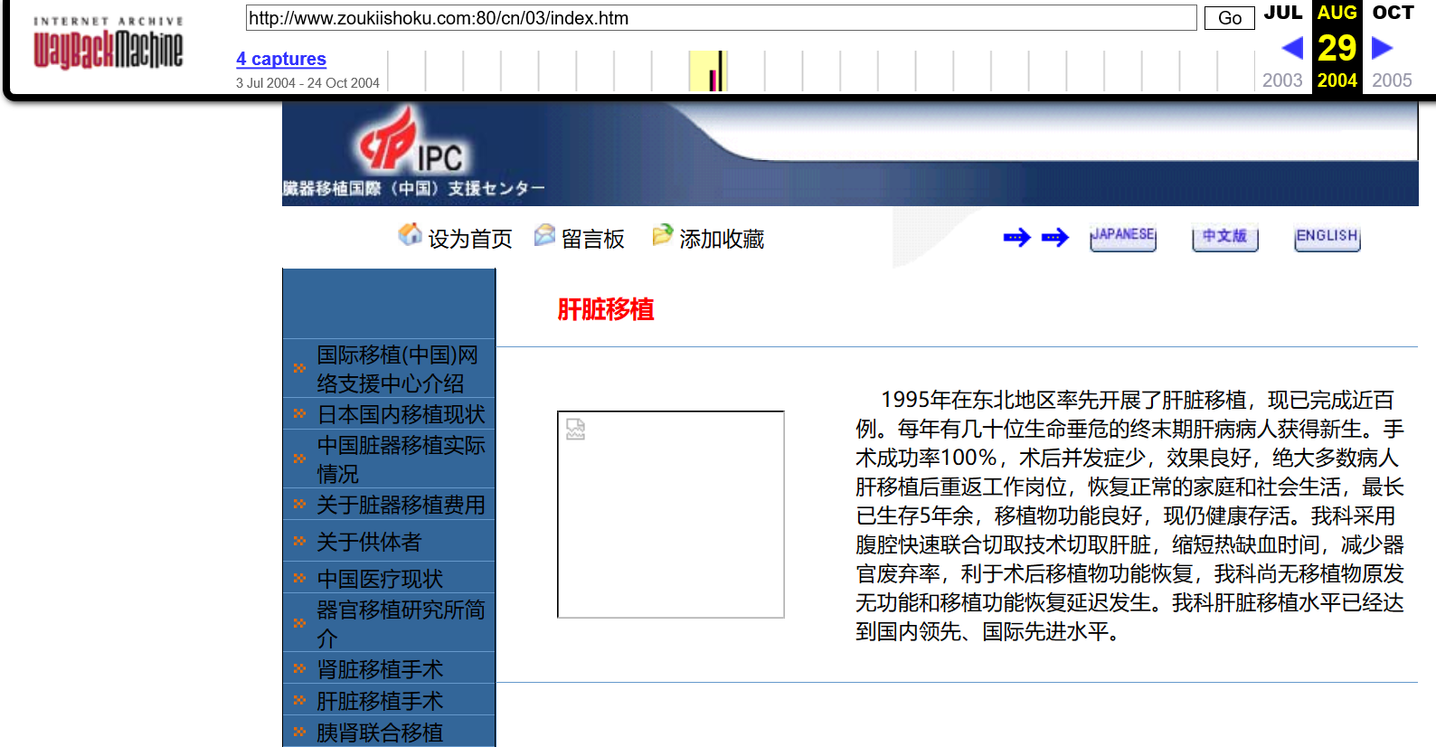
Liver extraction procedures with warm ischemia times (WITs) of 0-5 minutes had become an industry standard, well before China piloted its organ donation system
Medical papers published in China cited 0-10 min WITs
Most liver transplants in China were whole liver instead of partial liver transplants
Without organ donation system, such organs could only be obtained if organs were procured from living people, who were killed during organ procurement
Liver Transplant: Our department adopts peritoneal quick combined cutting technique to cut the liver, shorten the time of warm ischemia, reduce the rate of organ rejection, and facilitate the recovery of graft function …
Screenshot: China International Transplantation Network Assistance Center (2004)
Notes:
In the same period, Chinese surgeons developed liver extraction procedures with warm ischemia times (WITs) of under five minutes, which has since become an industry standard. Medical papers published in China also cited 0-10 min WITs.
Such short WITs could only be obtained if organs were procured from living people.
Unlike in other countries, most liver transplants in China were whole liver instead of partial liver transplants. CITNAC even adopted a rapid liver procurement technique that involves excising all abdominal organs simultaneously, which can reduce both damage to the liver and warm ischemia time. This technique is widely used in China’s transplant centers. This is the screenshot of CITNAC’s website.
Without an organ donation system, such organs could only be obtained if they were procured from living people, who were killed only as a result of the organ procurement process.

Slide 11
Characteristics:
Short Wait Times
2006 China Liver Transplant Registry report: more than 25% of liver transplant cases were emergency transplants for patients who required a transplant operation within 72 hours
2003-2006, Shanghai Changzheng Hospital claimed to perform 120 emergency liver transplants
In October 2017, a hospital quoted wait times of just days or weeks, with patients receiving expedited surgeries if additional monetary "donations" were made
Notes:
Since 2000, hospitals have quoted wait times between days and weeks, including for re-transplants in case of failure, while the wait time is years in other countries.
The China Liver Transplant Registry reported in 2006 that more than 25% of liver transplant cases were emergency transplants for patients who required a transplant operation within 72 hours. For example, between 2003 and 2006, Shanghai Changzheng Hospital performed 120 emergency liver transplants.

Slide 12
Volume Scenario
Liver and Kidney Transplant Capacity of the 146 Approved Hospitals
Based on the Ministry of Health’s Minimum Transplant Bed Count Requirements
Permit Type | Minimum Beds (1) | Annual Transplants (2) | Hospitals (3) | Annual Subtotal (4) | Years (5) | Total Transplants (6)
Liver | 25 | 300 | 21 | 6,300 | 15 | 94,500
Kidney | 30 | 360 | 65 | 23,400 | 15 | 351,000
Liver & Kidney | 55 | 660 | 60 | 39,600 | 15 | 594,000
Total |  |  | 146 | 69,300 |  | 1,039,500
(2) = (1) * 12 (one month hospitalization period) (4) = (2) * (3) (6) = (4) * (5)
Notes:
Secondly, let’s explore the scale of this industry.
As we said, the number of transplants conducted in China is a state secret, and the true number might never be known. However, we have found helpful clues from government regulations and policies. For example, in 2006, the Ministry of Health set these minimum bed counts for the transplant centers to maintain their qualifications. Among the approved transplant hospitals, 146 conducted liver and kidney transplants. This table is only a subset of the 164 approved transplant hospitals (for all organs).
Now if we take these minimum bed counts and calculate the number of transplants that could be done per hospital, even by a one-month hospitalization period and 100% bed utilization rate, then multiply that by the number of approved hospitals, we get the minimum system capacity of about 70,000 liver and kidney transplants per year. Over the course of 15 years, we’re looking at over a million transplants.
Of course, we have to keep in mind that this is the capacity of those hospitals, not the number of transplants actually performed. We found that the vast majority of hospitals far exceed these minimum requirements. Some have hundreds of beds dedicated to organ transplantation with bed utilization rates between 100% and 200%. In addition, there were more than 1,000 transplant hospitals in China in 2007, and many unapproved centers also continued to perform transplants. Therefore, the actual number of transplants performed yearly in China is likely to be much higher than this minimum system capacity.

Slide 13

Scale: Case Studies
Tianjin Oriental Organ Transplant Center
The new building opened with 500 dedicated transplant beds in 2006.
Bed utilization rate: 90% in 2009, 131% in 2013 before more beds were added.
With 500 beds, 100% utilization rate, and an average hospitalization time of 3 to 4 weeks, it could have performed 6,000 to 8,000 transplants per year.
2017 onsite investigation shows further expansion on its dedicated international transplant wards
China officially claimed between 10,000 to 15,000 transplants per year
The U.S. averaged 6,000 to 8,000 liver transplants per year in the same period
Notes:
Here are a few examples to give you a sense of how many transplants are performed in China.
The Oriental Organ Transplant Center in Tianjin opened in 2006 with 500 dedicated transplant beds. Its bed utilization reached 90% in 2009 and 131% in 2013 before more beds were added. Even with 500 beds, a 100% utilization rate, and an average hospitalization time of 3 to 4 weeks, its transplant volume could have reached 6,000 to 8,000 per year.
In October 2017, a group of Korean journalists visited this transplant center, where they observed this center housing foreign patients in a nearby hotel in addition to its own facilities, which includes three dedicated international transplant wards. These findings suggest that the center continues to perform thousands of transplants per year.
China officially claims between 10,000 and 15,000 transplants per year, but this figure is surpassed by just a handful of hospitals. As a side comparison, the United States only performed an average of 6,000-8,000 liver transplants in the entire country each year in the past two decades.

Slide 14

Scale: Case Studies
Dongfeng Hospital
“Kidney transplantation is now a routine surgery. Almost all surgeons at our hospital can independently complete kidney transplants.”
—Yuan Fangjun, hospital vice president
10 surgical departments with 100+ surgeons
In 2000: conducted 10 kidney and 3 corneal transplants in one day
Notes:
This push for high transplant volume is not limited to the big, national-level hospitals in big cities. It’s become a major business activity for municipal hospitals and hospitals of big companies as well.
One example is Dongfeng General Hospital, which is affiliated with an automobile company in Shiyan, which is a small industrial city in China. As early as August 2000, in one day it did 10 kidney transplants. The hospital’s vice president said in 2009, “Almost all surgeons at our hospital can independently complete kidney transplants.” They had more than 100 surgeons at that point. We had to ask ourselves how many transplants this hospital was doing to necessitate training almost all its surgeons in this procedure.
These are just the tip of the iceberg. The total number adds up quite quickly once we look at the big picture.

Slide 15

Ongoing Expansion
Increase from 169 approved transplant centers to 300 or 500 in the next few years
Notes:
There is enormous demand for transplants in China.
From what we’ve seen, many transplant centers have had bed utilization rates of 100-200%. Transplant centers have expanded significantly with more beds and new wards, wings, and buildings.
Huang Jiefu, China’s top transplant official, attributed the limiting factor not to organ availability but rather to a lack of qualified hospitals and experienced doctors. He announced plans in 2015 to increase the number of approved transplant hospitals from 169 to 300 and even to 500 over the next few years. This is part of the development roadmap.
As with all businesses, investments are made based on the expectation of profit. The massive expansion and growth of organ transplant centers in China indicates a confidence that there will be an abundant supply of organs well into the future.

Slide 16
1
Organ Sources
Extent to Which China’s Claimed Reform Has Been Implemented Since 2015
Organ Sources and
New Developments
2
3
New Developments

Slide 17
Organ Donation Reform
– An Assessment
Chinese Government Claims of Overnight Transition to Ethical Organ Sourcing
Before 2010
2010-2015
2015 to present
No organ donation system
Almost complete reliance on death-row prisoners and prisoners of conscience
2010: first pilot organ donation system implemented
2013: national donation system started, 23% of organs said to be donated
2014: 80% of organs said to be donated
Jan 2015: 100% of organs said to be donated
End of 2017: China’s claim of having 373,536 registered donors could only justify a dozen of actual organ donations.
The sum of reported donation numbers (mainly from non-registered donors in ICUs) in each region could not have covered even the official number of 15,000 transplants performed.
Before 2010
Notes:
Because of a longstanding cultural taboo and a lack of public trust in the medical system, voluntary organ donations are rare in China.
China didn’t start piloting an organ donation system until 2010, when death-row prisoner organs became “a stream without a source.” In 2013, two years after the national donation system started, 23% of organs were said to be donated. In 2014, 80% were said to be donated, and in January 2015, 100% were said to be donated.
However, the fact is that in 2013, the Red Cross stated that China had completed 207 donations. Considering that there were more than 169 approved transplant hospitals at the time, this was equivalent to an average of fewer than one donation per hospital per year.
It is implausible for China to have replaced organ procurement from death-row prisoners with voluntary donations within one year - 2014.

Slide 18
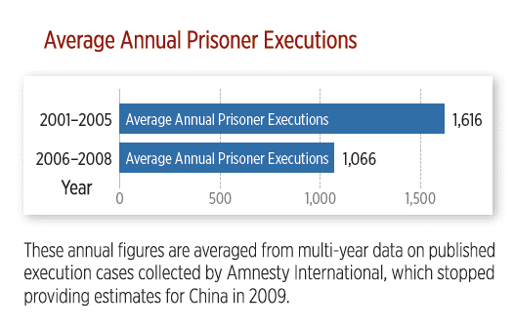
Death-Row Executions
Number treated as
state secret
Estimated 10,000
in year 2000 and
decreasing
Notes:
Now let’s look at death-row executions.
It’s hard to get specific figures for this because it’s treated as a state secret in China. What we do know is that estimates by international organizations have put it at around 10,000 per year in the year 2000, and there’s been a decreasing trend since then. This organ source could not have supported China’s ever-expanding transplant industry.
The Chinese regime has admitted to using organs from death-row prisoners, a relatively less severe abuse, to divert attention from the more severe issue, using innocent people whose only “crime” is their religious or political beliefs.

Slide 19

Donation System Used to Launder Organs
❍ Current regulations embed loopholes for illicit organ sourcing
China has not enacted fundamental laws that recognize brain death or govern organ sourcing, donation, procurement, allocation, and transplantation.
“China currently has a voluntary organ donation rate from living relatives of 1.1%. Over 98% of organ sources is controlled outside the Ministry of Health system.”
―Sanlian Life Weekly (2006)
“The departmental regulations, administrative policies and guidelines can only impose administrative penalties on the offender (up to a license revocation), and there is no criminal or civil liability; these rules are not enforceable in legal or penal systems—more organ sources come from them [than from the medical system].”
―Chen Zhonghua, a pioneer of organ donation (2006)
Notes:
When death-row prisoners’ organs became “a stream without a source,” China announced that it would pilot a voluntary organ donation system in 2010. However, China has not enacted fundamental laws recognizing brain death or governing organ sourcing, donation, procurement, allocation, and transplantation till now.
In 2008, Li Leishi, academician at the Chinese Academy of Engineering, told the media, “In China, organ donation after a citizen’s death exists [only] in theory.”

Slide 20
Donation System Used to Launder Organs
Donation system remains an empty shell
“The administration of organ donation and transplantation for 1.3 billion people is a big project, but right now there’s only one person.”
—Huang Jiefu, Chairman of the National Organ
Donation and Transplantation Committee (2017)
❍ Opaque operations
China’s Organ Procurement Organizations operate without oversight and are run by the same surgeons who are involved in unethical organ procurement and transplantation.
“Organ resources – all recipients and donors, the entire chain of organ transplantation – are in the hospitals.”
—Huang Jiefu (2013)
Notes:
The situation remains. Our findings show that the heavily publicized donation and allocation system, including COTRS, serves as a façade used to whitewash illicit organ sources. It does not function in practice or contribute significantly to the actual scale of transplants performed in China.

Slide 21
Donation System Used to Launder Organs
❍ Widespread Abuse of Brain Death Determination
“Among China’s donations so far, 70% are from brain-dead donors. Of the other 30%, many are from brain and cardiac death.”
“It’s impossible to include brain death in organ donation regulations. Most doctors don’t know how brain death works, very few truly understand the standards for brain death. Legislating brain death may not happen in another 20 years.
―Huang Jiefu, Chairman of the National Organ Donation
and Transplantation Committee (2017)
Notes:
Huang Jiefu said in 2017 that 70% of organs came from brain-dead donors; the other 30% were mainly from donation after brain death followed by cardiac death (DBCD). However, most of doctors in China were unaware of a standard procedure to determine brain death as of 2017. This contradiction suggests widespread abuse of brain death determination in China.

Slide 22
A Statistical Farce
Organ donation as of 2017 | USA | China
Registered as organ donors | 138,000,000 | 373,536
Deceased registered donors | 4,700 | 12.7
Deceased non-registered donors | 5,500 | 5000 (claimed)
Total deceased donors | 10,200 | 5,146 (claimed)
Total organ transplants from deceased donors | 28,500 | 14,190 (claimed)
Total organ transplants | 35,582 | 16,687 (claimed)
Median wait time (kidney) | 3.6 years | Days to weeks?
Notes:
The U.S. had 130 million registered organ donors in 2016. With a crude annual death rate of 8.2 per 1000 population, there would have been an estimated 1.07 million deaths of registered donors. There were 9,971 deceased organ donors.
China had 104,538 registered organ donors in 2016 and a death rate of 7.7 per 1000 population, which would yield an estimated 805 deaths of registered donors.
Even if its ratio of registered donor deaths and actual donors is similar to that of the U.S, this figure would translate to 7.5 donors.
Even CODAC’s figure of 373,536 registered donors at the end of 2017 would yield proportionally a dozen actual donors.
But China claims that 100% of organs are donated and routinely quotes waiting times in days to weeks. How is this possible?

Slide 23
Number of Donors in Top Provinces
Province | As Of | Total donors (All Time) | Average donors per year (Assuming All Occurred In Prior 3 Years) | Number of Approved Transplant Hospitals | Avg Donors Per Hospital Per Year
Guangdong | June 2017 | 2152 | 717 | 18 | 40
Hubei | Mar 2018 | 1625 | 542 | 7 | 77
Shandong | Dec 2017 | 1478 | 493 | 13 | 38
Zhejiang | Jul 2017 | 730 | 243 | 7 | 35
Sichuan | Nov 2017 | 424 | 141 | 4 | 35
Shanghai | Sep 2017 | 400 | 133 | 11 | 12
Liaoning | Oct 2017 | 245 | 82 | 6 | 14
Hebei | Apr 2018 | 230 | 77 | 3 | 26
Yunnan | Apr 2017 | 187 | 62 | 5 | 12
Anhui | Apr 2018 | 124 | 41 | 2 | 21
Heilongjiang | Apr 2018 | 55 | 18 | 2 | 9
In. Mongolia | May 2018 | 34 | 11 | 2 | 6
Notes:
Let’s look at the scale from another angle, the actual donations by regions.
The average reported donors per transplant hospital for the top provinces were just dozens each year. They could not accommodate even China’s minimum government-imposed transplant system capacity (based on minimum bed counts) in one year, let alone its on-demand nature and the number of actual transplants conducted.

Slide 24
Study Casts Doubt on
China's Organ Donation Data
China’s reported organ donation numbers don't stack up.
There is highly compelling evidence that they are being falsified: The figures appear to have been based on a quadratic function.
The study has been reviewed by a leading statistician: “The close agreement of the numbers of donors and transplants with a quadratic function is remarkable and is in sharp contrast to other countries who have increased their activity over this period...”
“The Chinese government may have been systematically misreporting the number of organs it claims it has voluntarily collected since 2010.”
―A new study published in BMC Medical Ethics in Nov 2019
Notes:
Furthermore, according to new research published in BMC Medical Ethics in November 2019, the Chinese government may have been systematically misreporting the number of organs it claims it has voluntarily collected since 2010.
https://bmcmedethics.biomedcentral.com/articles/10.1186/s12910-019-0406-6
Robertson, M.P., Hinde, R.L. & Lavee, J. Analysis of official deceased organ donation data casts doubt on the credibility of China’s organ transplant reform. BMC Med Ethics 20, 79 (2019) doi:10.1186/s12910-019-0406-6
The researchers' findings have been reviewed by one of the world's leading statisticians, Sir David Spiegelhalter, former president of the Royal Statistical Society in the UK:
"The anomalies in the data examined...follow a systematic and surprising pattern," Spiegelhalter wrote, "The close agreement of the numbers of donors and transplants with a quadratic function is remarkable and is in sharp contrast to other countries who have increased their activity over this period... I cannot think of any good reason for such a quadratic trend arising naturally."

Slide 25
Global Expansion
“The future transplant costs in China will still be the cheapest and most accessible in the world, and [the transplants will be] of high quality.”
―Huang Jiefu through Peng Pai News in August 2015
Cross-Strait Organ Exchange w/ Taiwan (2014)
Organ sharing agreements with Macau, Hong Kong, and Taiwan (Nov 2017)
One Belt, One Road (2017)
Notes:
Even though the sparse organ donations cannot even cover domestic needs, in 2014, Huang Jiefu went to Taiwan to propose a "cross-strait organ exchange platform" effectively to export human organs from the mainland to Taiwan, such that “patients would no longer need to travel from Taiwan to mainland China to undergo transplants.”
The China Organ Transplantation Development Foundation (COTDF) signed an organ sharing agreement with the Macau Health Bureau in November 2017. Residents of Macau, Hong Kong, and Taiwan can register for organs through COTRS, China’s new organ allocation system.
At the 2017 Chinese Transplant Conference, Huang Jiefu presented organ transplantation as part of China’s “One Belt, One Road” Initiative. The Initiative aims to strengthen cooperation in organ transplantation between China and other parts of Asia, Europe, East Africa, and Oceania.

Slide 26
Organ Tourism
China has become the organ transplant centre of the world
Tens of thousands of foreign patients flock to China for organs, including from South Korea, Japan, Malaysia, Egypt, Pakistan, India, Saudi Arabia, Hong Kong, Macao, Taiwan, Australia, Europe, and North America
In 2006, 85% of transplant patients at the Tianjin First Centre Hospital came from 20+ foreign countries and regions
After China’s organ crimes came to light, the Ministry of Health issued a ban on organ tourism to China in 2007
In 2016, Huang Jiefu stated both in China and abroad, “China strictly limits organ tourism. There has not been a single foreigner coming to China for transplant tourism.”

Slide 27
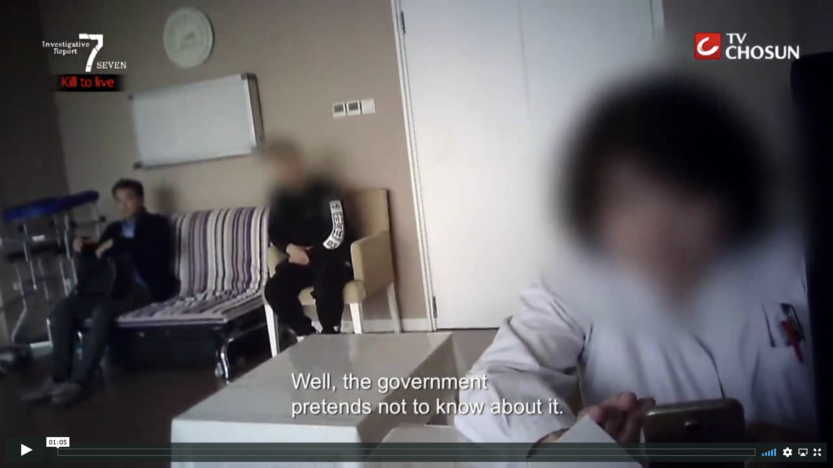

Recent Investigations Confirm
Ongoing Organ Tourism to China is Thriving
BBC investigation in 2018
Matthew Hill was told by a hospital in Guangzhou
that he could have a liver transplant within weeks.
October 2017 South Korean TV Journalists On-Site Investigation into a Tianjin Hospital
Hidden camera footage Tianjin Hospital
Notes:
Video link: https://vimeo.com/353397025/bd49393f76
However, recent Investigations confirm that organ tourism to China continues to thrive:
An on-site investigation by South Korea’s TV Chosun in 2017 showed a steady stream of international patients receiving organs at one of the largest transplant centers in China:
dedicated facilities and staff for international patients
high volume: 8 transplants on a single day in the international department
contradicts official statements that transplant tourism no longer occurs:
“The government pretends not to know about it”
“We have lots of foreign patients”
wait times: days to weeks (on demand)

Slide 28
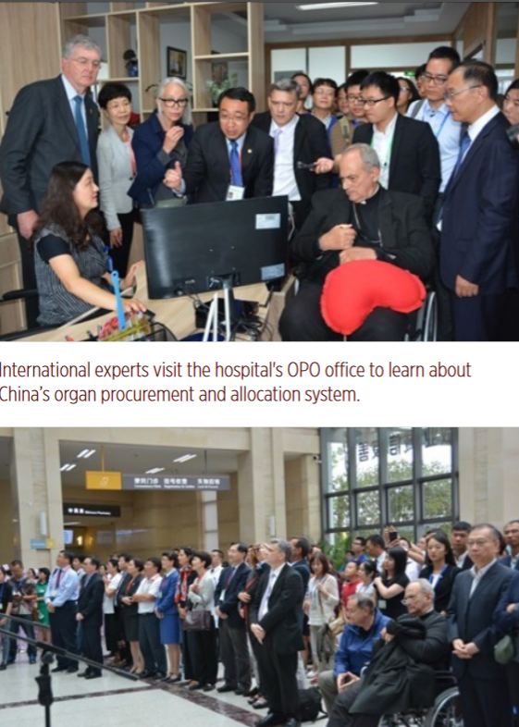
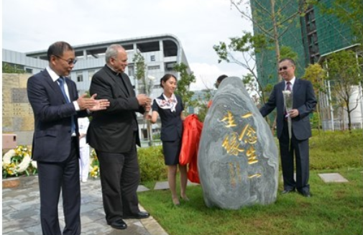
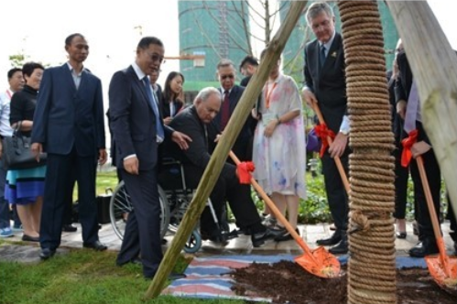
First “Open House” at a
Chinese Transplant Center
As China said it was “honestly opening a window” to its transplant system, Huang Jiefu invited international experts to tour the Calmette International Hospital at the Kunming First People's Hospital in August 2017. While the experts were awed by the showcase of China’s “amazing progress” in organ donation, the entire Yunnan province averaged only 47 voluntary organ donations per year over the prior four years, which could not even supply the organs used by this hospital alone.
Notes:
This was the first time China had opened a transplant hospital to international experts, who were to experience “the Chinese mode” of organ donation and transplantation.
The experts watched as donor organs were transported to the hospital by helicopter and sent to an operating theater through a “green passage.” They visited an Organ Procurement Organization (OPO) office to learn about the hospital’s process of organ procurement, allocation, and transplantation. They also visited a reception area for families of organ donors and equipment storage rooms.

Slide 29
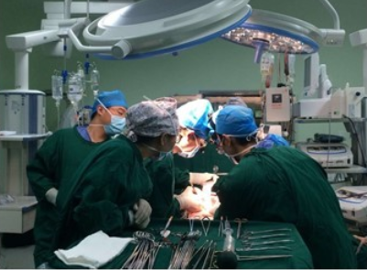
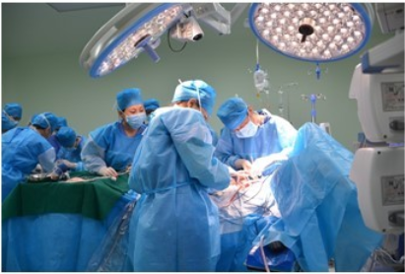
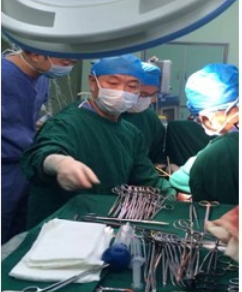
First “Open House” at a
Chinese Transplant Center
On October 19, 2016, the hospital performed 16 transplants in a single day. Approximately 140 medical personnel directly participated in the surgeries.
In March 2017, Calmette invited personnel from the Oklahoma Transplant Center in the United States to perform 15 transplant surgeries in 24 hours.
Notes:
While the experts were awed by the showcase of China’s “amazing progress” in organ donation, the entire Yunnan province averaged only 47 voluntary organ donations per year over the prior four years, which could not even supply the organs used by this hospital alone.

Slide 30
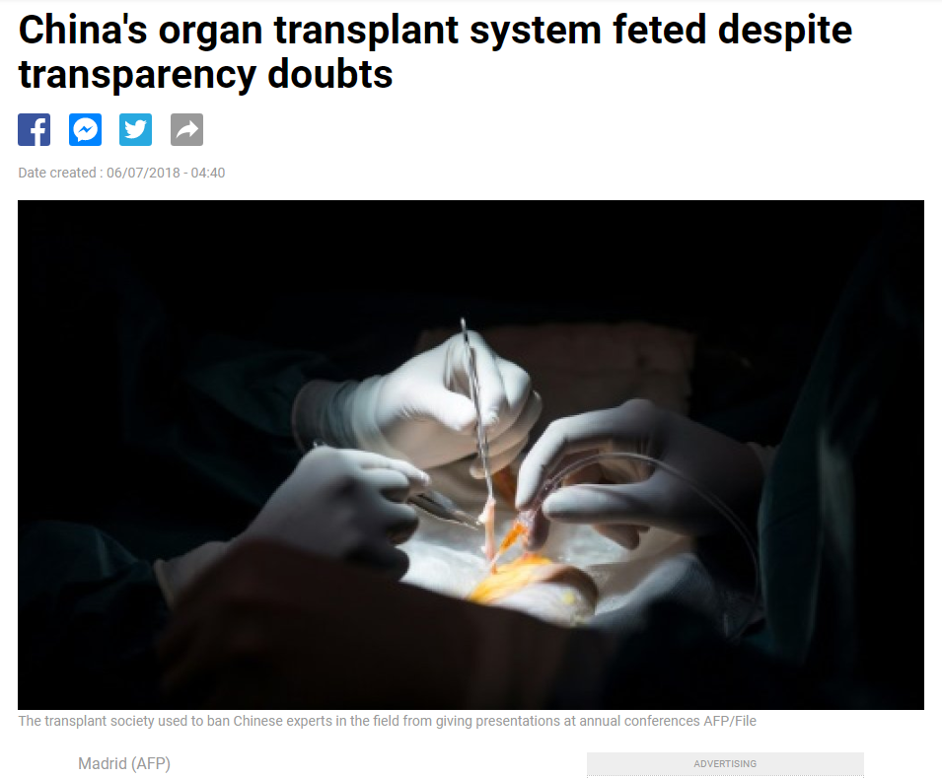
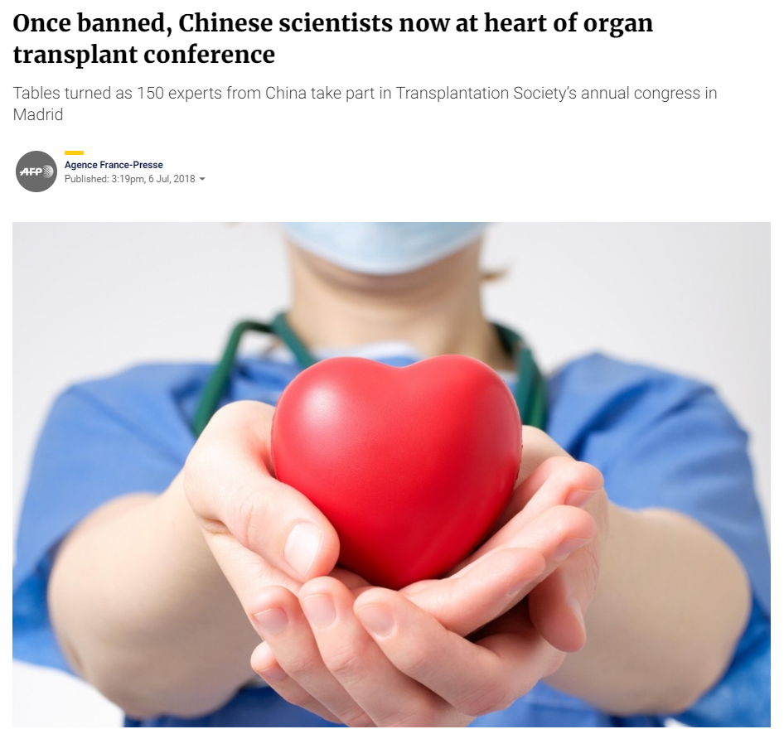
At the Transplantation Society’s annual congress in Madrid in July 2018, despite allegations of transplant abuses, 150 Chinese experts took part with their papers and presentations being widely adopted, and some Western transplant experts endorsing this country’s organ donation system.
Recognition Despite Lack of Transparency
Notes:
Nevertheless, through public relations campaigns using falsified data, presentations of unimplemented plans, and dismissing evidence of state-driven systemic abuse as isolated criminal cases, China’s claimed reform has gained endorsement and even promotion by some international transplant experts.
https://www.scmp.com/news/china/society/article/2154072/once-banned-chinese-scientists-now-heart-organ-transplant
https://www.france24.com/en/20180706-chinas-organ-transplant-system-feted-despite-transparency-doubts

Slide 31
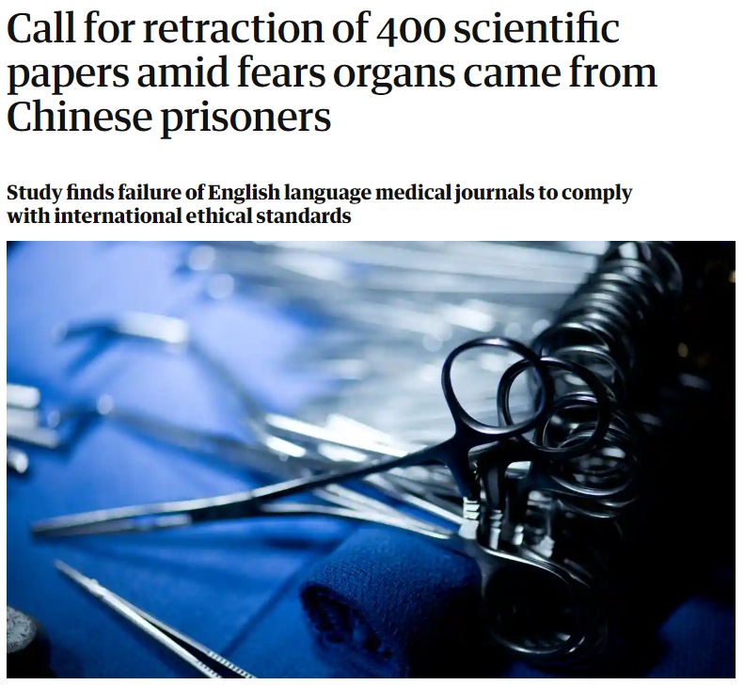

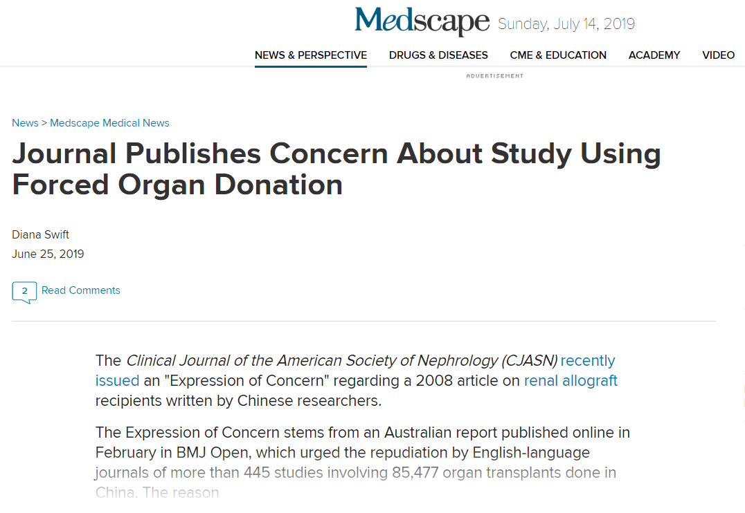
A 2018 review of 445 Chinese organ transplantation research papers published in peer-reviewed English-language medical journals between 2000 and 2017 found that more than 90% failed to meet international ethical standards banning publication of research involving biological material from executed prisoners.
International Ethical Standards Violated
Notes:
https://www.theguardian.com/science/2019/feb/06/call-for-retraction-of-400-scientific-papers-amid-fears-organs-came-from-chinese-prisoners

Slide 32
Global Expansion and
Ethical Implications
“International transplantation is like a boat, and for many years, China was swimming outside of the boat. Now the boat, with China jumping on board, is moving faster than ever before. China’s efforts are leading the boat’s way.”
  —José Núñez, Medical Director of the World Health Organization’s organ donation and transplantation program (August 2017 and February 2018)

Slide 33
Victims
1
Victims
2
Campaign to Eradicate Falun Gong

Slide 34
Victims
Historical Practices
Notes:
Early 1940s: “counter-revolutionaries” killed for cadavers
1960: China performs first organ transplant
1962: Central Military Commission issues guidance that all death-row and serious offenders can be disposed of according to the Party’s needs per “revolutionary protocol”
1978 - First documented organ harvesting from a prisoner of conscience, Zhong Haiyuan

Slide 35
Role of the State
“Being able to complete such a number of organ transplant operations is inseparable from the government’s support. The Chinese government’s Supreme People's Court, Supreme People's Procuratorate, Public Security system, judicial system, Ministry of Health, and Ministry of Civil Affairs jointly promulgated regulation on October 9, 1984 and established that organ procurement would be an activity supported by the government. This is a one of a kind in the world.”
Notes:
You may remember from the video when a major transplant center thanked the government for supporting its organ procurement activities. This refers to a regulation passed in 1984 that allows the bodies and organs of prisoners to be used under certain conditions.
During the persecution of Falun Gong, this regulation justifies the sourcing of organs from Falun Gong practitioners who refuse to disclose their identities without consent of either themselves or their family members, even though they have not been sentenced to death.
Huang Jiefu’s announcement about stopping the use of organs from death-row prisoners has no legal effect and cannot be traced to any official policy statements or laws. Organ harvesting is still supported and protected by the government today.

Slide 36
Abrupt Increase Without
Organ Donation System
Since 2000, the PRC government prioritized organ transplantation in national strategy and Five-Year Plans with no voluntary donation system
Led by heavy investment in research and industrialization, China’s transplant system has grown exponentially and become the most prolific in the world in several years.
    150 centers in 1999 ➔ 570 centers in 2004 ➔ 1,000 + centers in 2007
    Transplant volume increased 30-fold between 1999 and 2005
Notes:
Starting in 2000, the PRC government has prioritized organ transplantation in its national strategy and Five-Year Plans with no attention given to a voluntary donation system. With heavy investments in organ transplant research and industrialization, China’s transplant system grew exponentially and became the most prolific in the world in the next few years, despite the lack of an organ donation system. The number of transplant centers also ballooned.

Slide 37
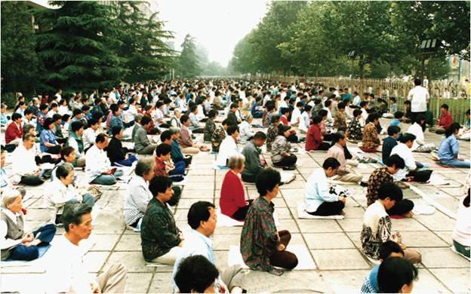
Main Victims After 2000
Buddhist self-cultivation practice
No religious formality or membership structure
Freely taught around the world
Estimated 70 million practitioners in 1999 before crackdown
Notes:
Before and after
This extremely quick growth happened alongside the start of a campaign by the Communist Party to wipe out Falun Gong, as we saw in the video.
The main issue is not about the organs from executed death-row prisoners. Huang Jiefu made death-row organs a big issue, but the more severe problem is the organs from Falun Gong practitioners, which the government has not acknowledged.
What we’ve seen is a state-driven crime.
A lot of people may be wondering: how did the Party get doctors and other people to go along with killing people for organs?

Slide 38

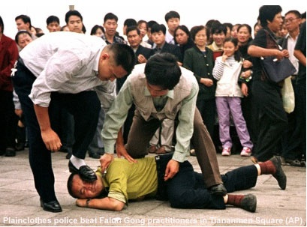
Eradication Campaign
Chinese Communist Party banned Falun Gong in 1999 in violation of the Constitution
Directives: “Crush them politically, cut them off financially, and destroy their reputation”
100% “transformation” without exemption
“Deaths of Falun Gong practitioners from beating are nothing and shall be counted as suicide; the bodies shall be directly cremated without investigating the person’s identification.”
In 2001, the campaign against Falun Gong was included in China's Tenth Five-Year Plan
Meanwhile, organ transplantation has been prioritized in China’s national development strategy without a voluntary organ donation system
Notes:
The Communist Party’s former leader Jiang Zemin saw Falun Gong’s popularity as a threat to his rule. In violation of the Chinese Constitution, Jiang launched a campaign in 1999 to ruin their reputations, bankrupt them financially, and destroy them physically. Under the instruction of 100% “transformation” without exemption, Falun Gong practitioners have been systematically arrested and tortured in prisons, labor camps, and secret detention facilities for refusing to renounce their faith.
In 2001, the campaign against Falun Gong was included in China's Tenth Five-Year Plan. Meanwhile, organ transplantation has been prioritized in China’s national development strategy without a voluntary organ donation system.

Slide 39
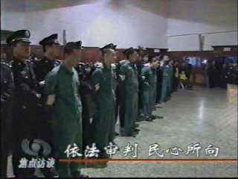
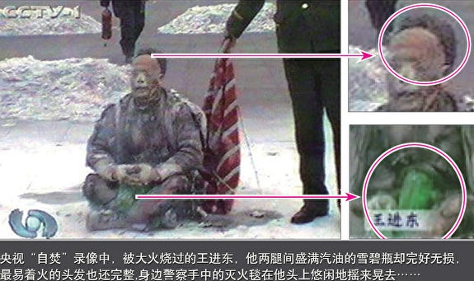
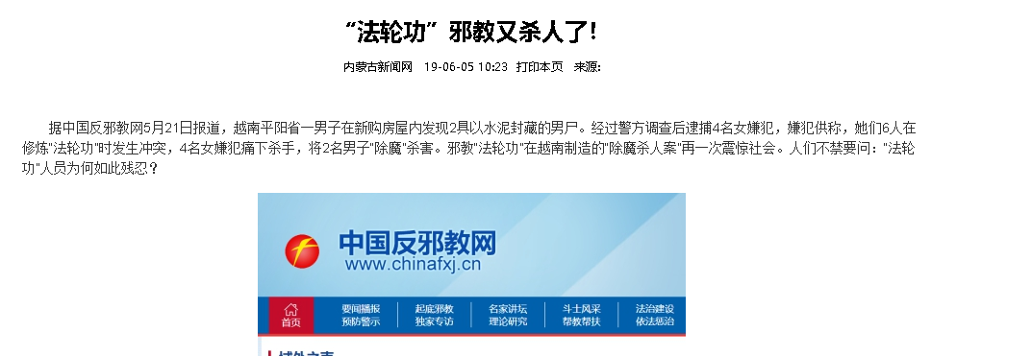

Demonization and Propaganda
Notes:
Violence often originates from hatred, and hatred usually arises from distorted information. This is thoroughly reflected in the Chinese regime’s persecution of Falun Gong.
The party-state has used nationwide propaganda campaigns as key tools in its suppression of Falun Gong. Since the persecution began in July 1999, the regime has used more than 3,000 newspapers and magazines, as well as hundreds of television and radio stations, to spread propaganda defaming Falun Gong.
The demonization of and incitement to hatred toward Falun Gong provided a basis on which crimes against practitioners could be justified.

Slide 40
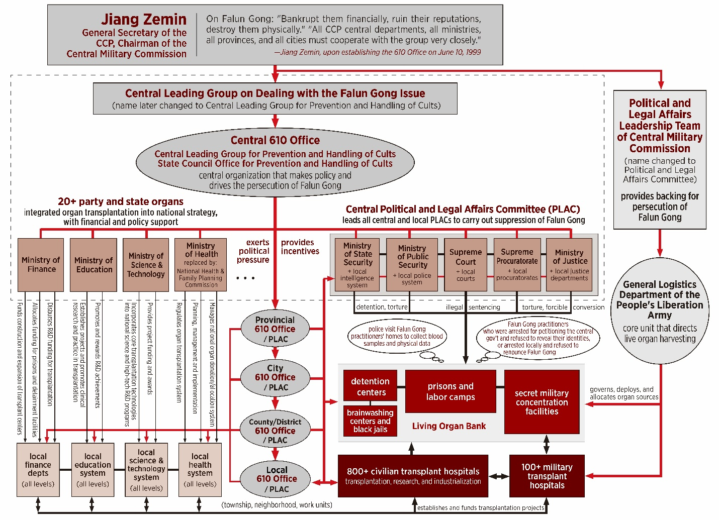

Drivers
Notes:
This diagram shows the power structure the Communist Party leadership set up to carry this out. It’s a state-led campaign.
When Jiang Zemin started to persecute Falun Gong, there was no legal basis for doing so. Jiang decided to start a political campaign and established an extralegal chain of command centered around what was called the “610 Office.” The 610 Office has been endowed with extraordinarily broad and extralegal powers to systematically eradicate Falun Gong. Through the 610 system, the Party mobilized the entire state apparatus to carry out this campaign, which includes organ harvesting in its directives.

Slide 41
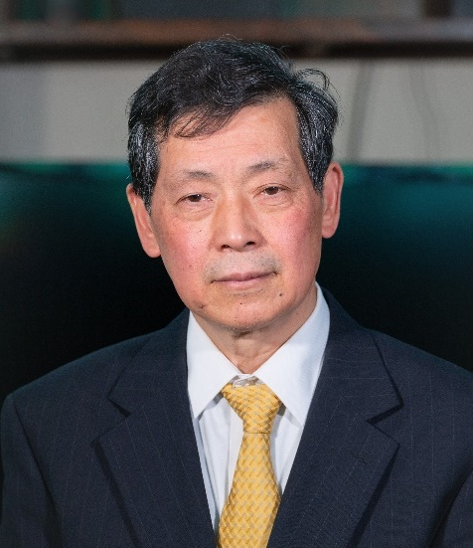

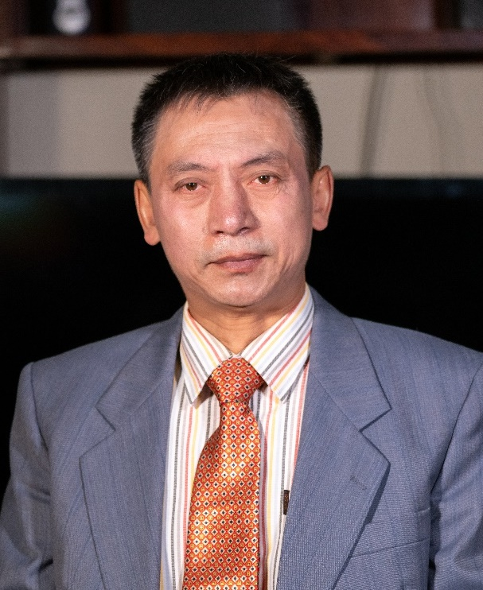

Testimonies
This video includes clips of first-hand testimonies from
witnesses of historic events of the Chinese communist regime's campaign to eradicate faith groups
survivors of torture who were detained for their beliefs
relatives of suspected organ harvesting victims and other missing persons

Slide 42
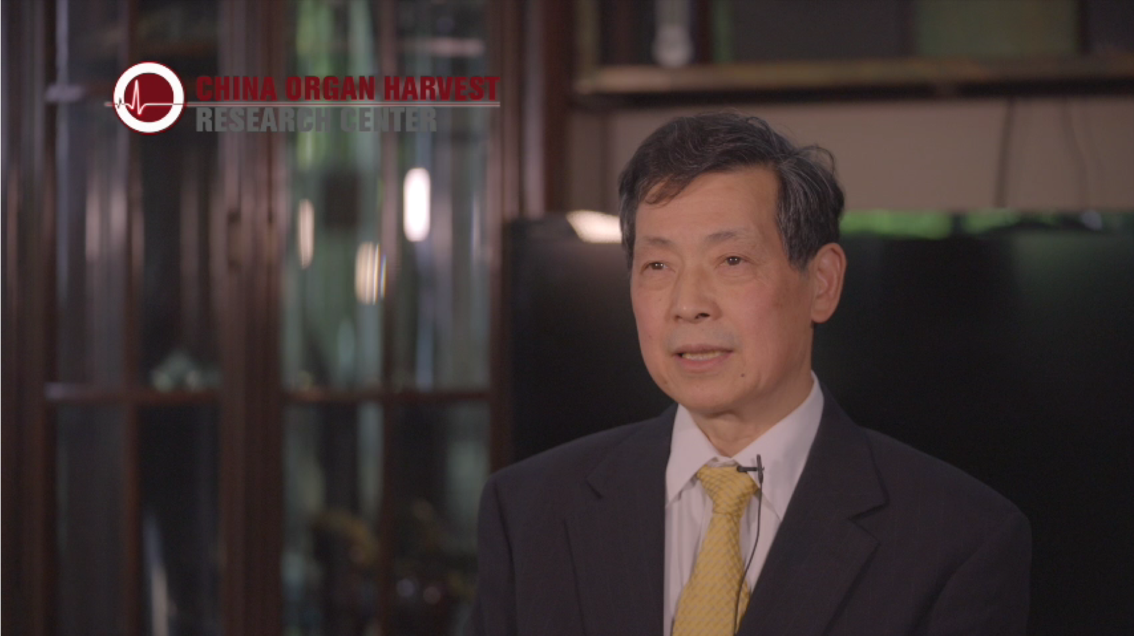
Notes:
play video at link: https://vimeo.com/348679809/110306efbb

Slide 43
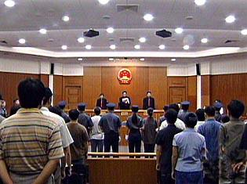
Judiciary Used as Tool of Persecution
Instructions from the Central 610 Office: “No law regulates the treatment of Falun Gong practitioners”
Denial of due process and access to attorneys
Courts and procuratorates decide all cases via Party directives
Attorneys not allowed to plead innocent
Attorneys who defend Falun Gong are similarly persecuted

Slide 44
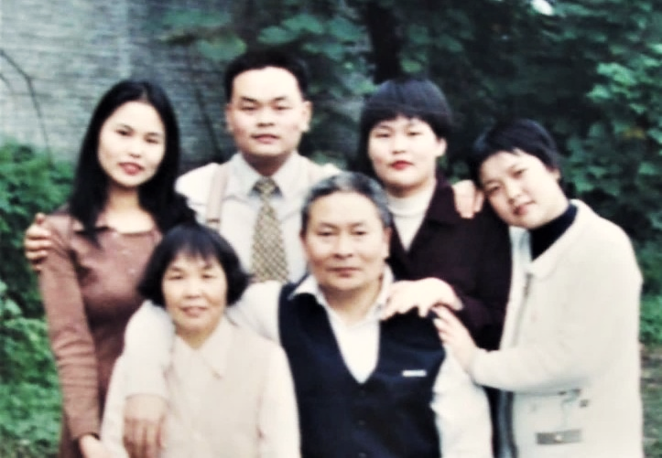
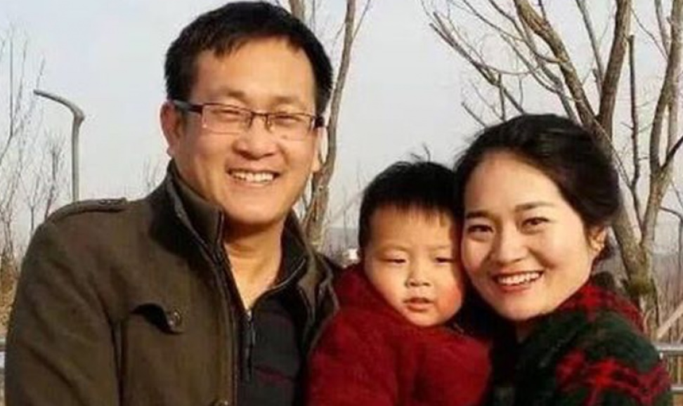
Judiciary Used as Tool of Persecution (Examples)
Jiang Xiqing, a victim of forced organ harvesting
Wang Quanzhang, a persecuted attorney
Notes:
Here are two examples:
One example is Jiang Xiqing’s case, which we saw in the video testimonies:
Jiang Qingxi was put into a mortuary freezer when he was still alive. His family members were forcibly removed from the facility when they found him still alive and tried to rescue him. The entire process was directed, monitored and conducted by the local police bureau. Many police cars were parked around the mortuary, and many armed police officers surrounded the perimeter wall.
Among the persecuted attorneys was Wang Quanzhang, who was illegally arrested in August 2015 and disappeared for more than a thousand days for defending the rights of Falun Gong practitioners. His wife revealed that he was often threatened and beaten by the authorities: “When Quanzhang was defending a Falun Gong practitioner once, he said one sentence, and a bailiff slapped him in the face and asked if he wanted to keep talking. He did, so he was hit again. Altogether he was hit more than a hundred times.”

Slide 45
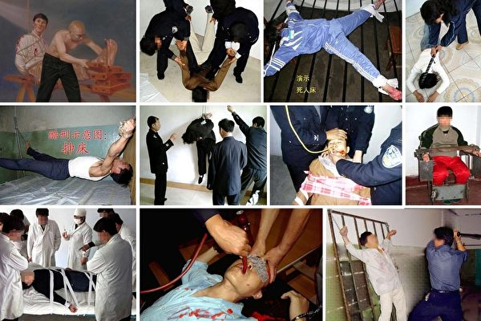
Transformation and Torture
Goal of transformation: force believers into giving up their faith
implications for co-workers, family members, communities, police officers, and doctors
Over 100 forms of torture methods documented
Notes:
The Chinese regime uses intricately designed mental and physical torture methods to force Falun Gong practitioners to renounce their faith and betray their conscience:
Shocking with electric batons
Rape, gang rape and sexual torture
Burning with hot metal rods, melted wax and boiling water
Beating with spiked sticks, leather whips and steel bars
Hammering bamboo sticks and metal nails into fingers
Forced administration of psychiatric drugs

Slide 46
Physical Destruction
“Opposing Falun Gong is a grave political struggle. We must not be softhearted when dealing with a little group of hardcore reactionaries.” —Huang Jiefu (2001)
“Anybody, if they label themselves [anything] other than communist, or Communist Party member, then they will be treated as an enemy of the state. Therefore, they are not even qualified as human beings. Therefore, they are subject to whatever punishment is available.” —Enver Tohti, a former Uyghur surgeon
“All the livers are directly extracted at the source … We don’t care whether it’s from a Falun Gong practitioner or not. We don’t get involved in politics. As doctors, we only care about the donor liver, about whether it meets the requirements of transplantation. If it meets the requirements, we don’t care who it’s from.”
— Tan Yunshan, Director, Liver Disease Department, Zhongshan Hospital, Fudan University
Notes:
When the regime faces practitioners who refuse to “transform” under torture, it uses physical destruction as the last method to achieve its desired “100% conversion rate.”
The physical destruction has been carried out through the Chinese law enforcement system by torturing Falun Gong practitioners to death and killing them through the administration of nerve, organ, and/or brain-damaging drugs. It has also been carried out through the Chinese medical system by harvesting the organs of Falun Gong practitioners to supply the organ transplant industry.
Officials in China’s organ transplantation system also actively implemented this campaign by publishing anti-Falun Gong propaganda. For example, Huang Jiefu, the de facto person in charge of organ transplantation, actively incited hatred of Falun Gong in earlier years by propagating the Party’s rhetoric against the group in the medical community.
Enver Tohti, a former Uyghur surgeon who was told to extract organs from a living prisoner, explains in his testimony the indoctrination techniques that have enabled doctors to rationalize harvesting organs from living people.

Slide 47
Largest Groups of Victims
Falun Gong: 70 million when the persecution started in 1999
  persecution unmatched in scale, sophistication, cruelty and longevity
Uyghurs: 24 million in Xinjiang
  more recent and limited in scope
  more evidence of organ harvesting could emerge over time
The lives and fates of different groups are all intertwined. Risk to one group is risk to all.
Notes:
To be clear, we don’t want to discount the impact of such a horrific crime on any particular victim group, but we do see a difference in relative proportions.
From the evidence we have seen, most organs come from Falun Gong practitioners, the largest group openly targeted by the Communist Party. There were more than 70 million Falun Gong practitioners when the persecution started, they are distributed all over the country, and for most of the past 20 years, they were the largest group of prisoners of conscience in China. At least hundreds of state and military hospitals all over China have participated in these illicit transplants.
Relatively speaking, the concerted persecution and targeting of Uyghurs for organ harvesting is more recent and limited in scope, both in number and geographic coverage. More evidence of organ harvesting from this group could emerge over time.
The Party is expanding its targets for reeducation campaigns, surveillance, and organ harvesting to exploit much larger populations across China.

Slide 48
Violations of International Law
1
Crimes Against Humanity
2
Genocide

Slide 49
Genocide
Article II of the United Nations Convention on the Prevention and Punishment of the Crime of Genocide states:
“In the present Convention, genocide means any of the following acts committed with intent to destroy, in whole or in part, a national, ethnical, racial or religious group, as such:
Killing members of the group;
Causing serious bodily or mental harm to members of the group;
Deliberately inflicting on the group conditions of life calculated to bring about its physical destruction in whole or in part;
Imposing measures intended to prevent births within the group; and
Forcibly transferring children of the group to another group.
Notes:
The first of our allegations against the PRC is genocide. Article II of the UN Convention on Genocide sets forth three elements of genocide:
acts that are indicative of genocide
protected group
intent to destroy, in whole or in part

Slide 50
Acts of Genocide
Killing members of the group
Causing serious bodily or mental harm
Easily satisfied in the form of murder, extermination, torture, rape, organ harvesting etc.
Notes:
3 elements
Evidence was a slam dunk with respect to 2 out of 3:
acts clearly indicative of genocide
Falun Gong is clearly a group of the type intended to be protected under the statute
The China Tribunal found Intent to be problematic – given the evidence gathered to date, the Tribunal had some concerns and unanswered questions.
But the Tribunal did not exonerate China with respect to Genocide.

Slide 51
Targeting of Falun Gong as a Group
Falun Gong is a protected religious group
Persecution targets Falun Gong practitioners for “transformation,” i.e. giving up one’s beliefs via forced conversion methods
Whether a practitioner is released depends entirely on one’s willingness to sign renunciation of religious beliefs
Notes:
Falun Gong is a Buddhist meditation system that was independent of the government agencies that manage religion in China.
Practitioners are targeted for “transformation” and pressured to renounce their beliefs.

Slide 52
Specific Intent
Clear from directives and actions
June 1999 – former Chinese President Jiang Zemin issues direct orders to eradicate Falun Gong in speech to Politburo
“Crush them politically, cut them off financially, and destroy their reputation”
Campaign of mass arrest, killings and torture
Notes:
While the Tribunal was hesitant to find that organ harvesting itself constituted genocide because of the possible complicating motive of profit seeking,
the overall campaign against Falun Gong, of which organ harvesting is just one tool, satisfies the elements of genocide pretty comfortably.
The Tribunal invited the UN General Assembly to solicit an advisory opinion on the issue from the International Criminal Court.

Slide 53
Crimes Against Humanity
Crimes against humanity: “… acts when committed as part of a widespread or systematic attack directed against any civilian population, with knowledge of the attack”
The Rome Statute of the International Criminal Court
The Rome Statute also requires that the attack be “pursuant to or in furtherance of a State or organizational policy.”
Notes:
4 elements:
prohibited acts
widespread or systemic attack
knowledge of the attack
state or organizational policy

Slide 54
Applications to Laws: Crimes Against Humanity
The acts prohibited by all three United Nations statutes
(and the Rome Statute) defining crimes against humanity:
  murder;
  extermination;
  enslavement;
  deportation;
  imprisonment;
  torture;
  rape;
  persecutions on political, racial and religious grounds; and other inhumane acts
Notes:
What acts are prohibited by the statutes?
murder and extermination – ample and indisputable evidence of both
enslavement – many detainees are forced to manufacture products that are sold internationally
Those holiday decorations you bought? May well have been put together in a Chinese prison or detention center by a prisoner of conscience who was not paid for his or her work – see new documentary film Letter from Masanjia
deportation may be the only act that is not relevant
imprisonment, torture, rape, religious persecution – indisputable evidence of all
Summary: 7 out of 8 acts feature prominently in the persecution of Falun Gong

Slide 55
Widespread or systematic attack
“Widespread” refers to large-scale nature of attack, primarily reflected in the number of victims
  Widespread in geography, frequency and number of victims
“Systematic” refers to the organized nature of the attack and recurrence on a regular basis, often involving a “pattern of methodical plan”
  Systematically planned by top CCP officials and carried out via organized structure led by the 610 Office
  Industrial-scale mobilization of both civilian and military organizations targeting millions of Falun Gong practitioners across the country easily satisfies this requirement

Slide 56
Knowledge of Attack
Carefully planned out nationwide campaign evidences more than just “knowledge”
Direct calls for prohibited activities against Falun Gong by e.g. Jiang Zemin
Admissions by officials and other related parties
Notes:
Actors knew they were engaged in a campaign
Jiang’s Politburo speech
Admissions

Slide 57
State Policy
Attack on Falun Gong practitioners, including forced organ harvesting, is result of directives issued by the highest levels of the CCP
Active supervision and in some cases, direct involvement of governmental agencies
Disenfranchisement of basic rights to counsel and fair trial

Slide 58
1
China Tribunal
2
Legislative efforts against organ transplant abuse around the world
Legislative Efforts to Combat the Crimes
3
Bill S-240 in Canada
4
Policy and legislation reforms to address the issue in the US

Slide 59

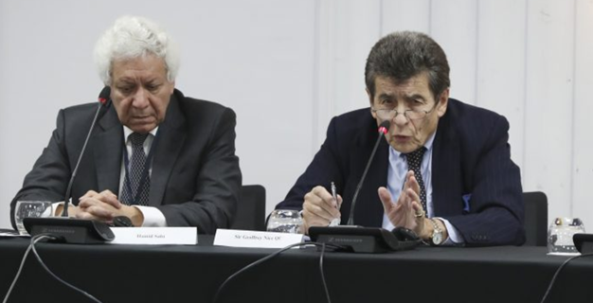
China Tribunal’s Main Conclusions
Forced organ harvesting has been committed for years throughout China on a significant scale and that Falun Gong practitioners have been one – and probably the main – source of organ supply. The concerted persecution and medical testing of the Uyghurs is more recent and it may be that evidence of forced organ harvesting of this group may emerge in due course.
The Tribunal has had no evidence that the significant infrastructure associated with China’s transplantation industry has been dismantled and absent a satisfactory explanation as to the source of readily available organs concludes that forced organ harvesting continues till today.
Hamid Sabi (Counsel)
acted as Counsel and Rapporteur to the Iran Tribunal (2007)
Sir Geoffrey Nice QC (Chair)
led the prosecution of Slobodan Milošević, former President of Serbia, at the UN’s International Criminal Tribunal (1998 – 2006)
Notes:
China Tribunal – a panel of 7 judges, all known leaders in the fields of law, medicine and international relations
Led by Sir Geoffrey Nice, a British attorney with over 40 years of experience as a barrister and judge. Between 1998 and 2006, he led the prosecution in the trial of former Yugoslavian president Slobodan Milosevich at the UN’s International Criminal Tribunal following the civil war in Yugoslavia.
Tribunal’s conclusions:
1) Forced organ harvesting has been going on for years on a large scale
2) Falun Gong practitioners are probably the main source of organ supplies
3) There is no evidence that China has abandoned the practice

Slide 60
“Taken together, such attacks and such acts constitute crimes against humanity, which the Tribunal is certain, beyond reasonable doubt, have occurred.”
—Sir Geoffrey Nice QC, the China Tribunal
Notes:
This quote from Sir Geoffrey Nice towards the end of their presentation says it all.
There is overwhelming evidence that China has committed crimes against humanity in its persecution of Falun Gong.

Slide 61
Background of Legislative Efforts
Against Organ Transplant Abuse Around the World
In December 2013, the European Parliament adopted an emergency resolution 2013/2981(RSP) calling on the Chinese regime “to end immediately the practice of harvesting organs from prisoners of conscience and members of religious and ethnic minority groups.”
In June 2016, the U.S. House of Representatives unanimously passed House Resolution 343 condemning "the systematic, state-sanctioned organ harvesting from non-consenting prisoners of conscience" in China
Israel, Spain, Italy, Taiwan, Norway, and Belgium have passed laws criminalizing organ trafficking and restricting transplant tourism to China
Notes:
Since this crime was first reported in 2006, some governments have passed resolutions and legislation to imposed criminal penalties to restrict illicit organ tourism, as well as resolutions condemning the atrocities.

Slide 62
Case Study: Bill S-240
Introduction
Objective: Punish those who participate in forced organ harvesting anywhere around the world and stem organ tourism to countries such as China.
Passed unanimously by the Senate on October 23, 2018
Passed unanimously by the House of Commons on April 30, 2019
Unfortunately, parliamentary session ended before the Bill was confirmed

Slide 63
Case Study: Bill S-240
Provisions
Establishes four related criminal offences:
Receiving organs without donor’s informed consent
Participation/facilitation in organ removal without donor’s
informed consent
Receiving organs for consideration
Participation/facilitation in organ transactions

Slide 64
Case Study: Bill S-240
Provisions
Mental Element: Knowledge or recklessness (i.e. awareness that the organs are potentially removed without donor’s informed consent, or removed for consideration, but continues to act despite this awareness)
Extraterritorial application: Offenders can be prosecuted in Canada, even though the offending acts took place abroad (subject to the consent of the Attorney General)
Offenders are inadmissible to Canada (i.e. not allowed to enter Canada, and those within Canada can have their immigration status revoked)

Slide 65
Case Study: Bill S-240
Justification
Close legal loophole — comprehensive regulations for domestic organ transplant, but no law or regulation for organ transplant abroad
Giving effect to the principle against organ commercialism, established in the Istanbul Declaration
Stop and deter Canadian complicity in human rights violations involving organ transplant abuse

Slide 66
Proposed Strategies for Legislation and Policy Reform in the U.S.
The United States is both obligated and well-positioned to enact policies to help end the killing for organs and prevent complicity by international parties
The principles and ideals on organ transplantation, expressed by the Istanbul Declaration, can only become reality if domestic regulations on organ transplantation is matched by regulations on organ transplant activities taking place broad.
Otherwise, domestic regulations, far from safeguarding organ transplant activities, will only redirect such activities to countries with the worst organ transplant abuse.

Slide 67
Proposed Strategies for Legislation and Policy Reform in the U.S.
Proposed strategies include:
Publicly condemn forced organ harvesting in China by issuing a public statement or resolution;
Voice support for legislative measures to criminalize organ trafficking and transplant tourism to China;
Requiring more substantive verification of ethical organ procurement as a requirement for collaboration and business transactions
Expansion of independent investigations into transplant abuse in China, and awareness and education initiatives.

Slide 68



The wrongs which we seek to condemn and punish have been so calculated, so malignant, and so devastating, that civilization cannot tolerate their being ignored, because it cannot survive their being repeated.”
– Chief American prosecutor Justice Robert Jackson delivers the opening speech of the American prosecution at the International Military Tribunal trial of war criminals at Nuremberg. November 21, 1945
Notes:
As a historical reference, 70 years ago, when Nazi doctors stood trial at Nuremberg after World War II, the chief American prosecutor Robert H. Jackson said, “The wrongs which we seek to condemn and punish have been so calculated, so malignant, and so devastating, that civilization cannot tolerate their being ignored, because it cannot survive their being repeated.”
Unfortunately, such crimes against humanity have been repeated, and it has been happening since the beginning of this century. This requires a response.

